Slide 1
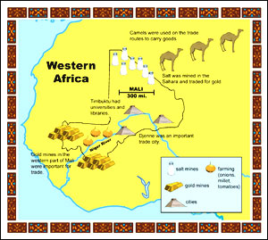
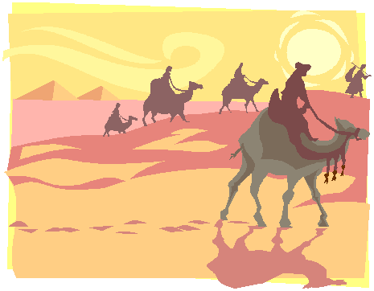
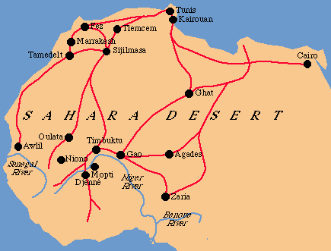
Western African Civilizations: Ghana, Mali, & Songhai

Slide 3
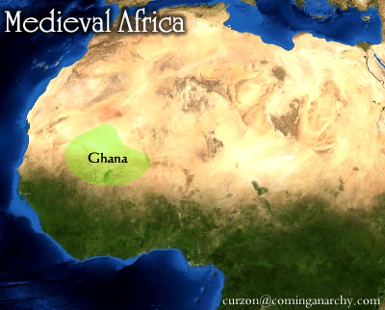
Ghana
The first of the West African trading kingdoms
Through weapon making technology (iron smelting), Ghanaian warriors expanded boundaries
Gained control over trade routes

Slide 4
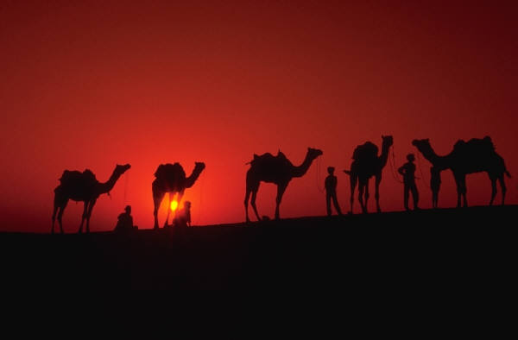
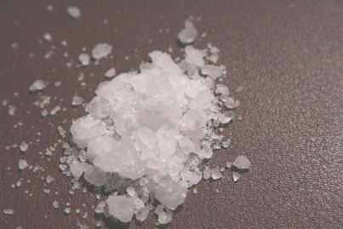
Ghana
Gold Salt Trade
Location! Location! Location!
Ghana was located in the midway between Saharan salt mines and tropical gold mines
Caravans of Muslim merchants brought goods, which Ghanaian people exchanged for gold
Trade conducted via the silent trade
Muslims brought their religion to the people of Ghana

Slide 5
The Ghana Empire

Slide 6
Salt as a commodity
http://www.history.com/shows/mankind-the-story-of-all-of-us/videos/salt
Notes:
Tried watching this at home and it was like 5 ads in a row and never started!!

Slide 7
Salt Mines
Notes:
Love this video!

Slide 8
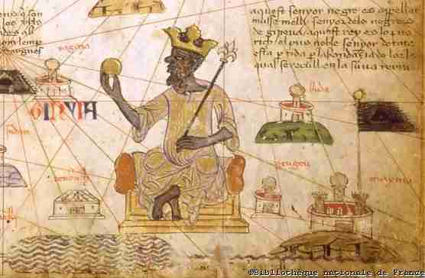
Mali
Mansa Musa
Devout Muslim king
Bases legal and justice system on the Qur’an
Makes hajj to Mecca, but stops in Egypt first
Gives Egypt so much gold that the value of gold declines for 10 straight years
Traveled with 12,000 servants each wearing silk & carrying gold bars, which were given to the poor

Slide 9
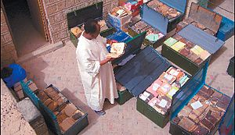
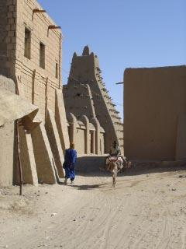
Mali
Mansa Musa
Brings back Islamic scholars and architects to Mali
Builds city of Timbuktu
Timbuktu
Center of learning and art
Increased Islamic influence in West Africa
Use of credit
Written contracts
Education for many classes

Slide 10
Timbuktu
Watch to 2:50 Min and start at 23-25 min
Notes:
It’s the same video (this one and the one that wasn’t working) lol. I started watching it and was like this looks familiar. The times work as well

Slide 11
Mansa Musa Videos

Slide 12
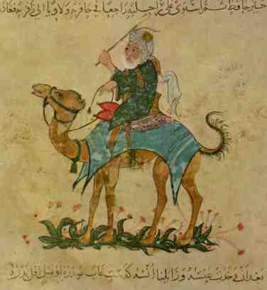
Ibn Battuta
Moroccan born traveler and explorer
Travel the Islamic world from North Africa to China
Spent 30 years traveling
His primary source writings inform historians about the Muslim world in Africa

Slide 13
Answer the following question:
Much of the wealth of the West African kingdoms of Ghana and Mali was gained from the
Sale of slaves to Europeans
Creation of colonies on the Mediterranean coast
Taxation on goods brought by Indian merchants
Control of the trans-Saharan trade in gold and salt.

Slide 14
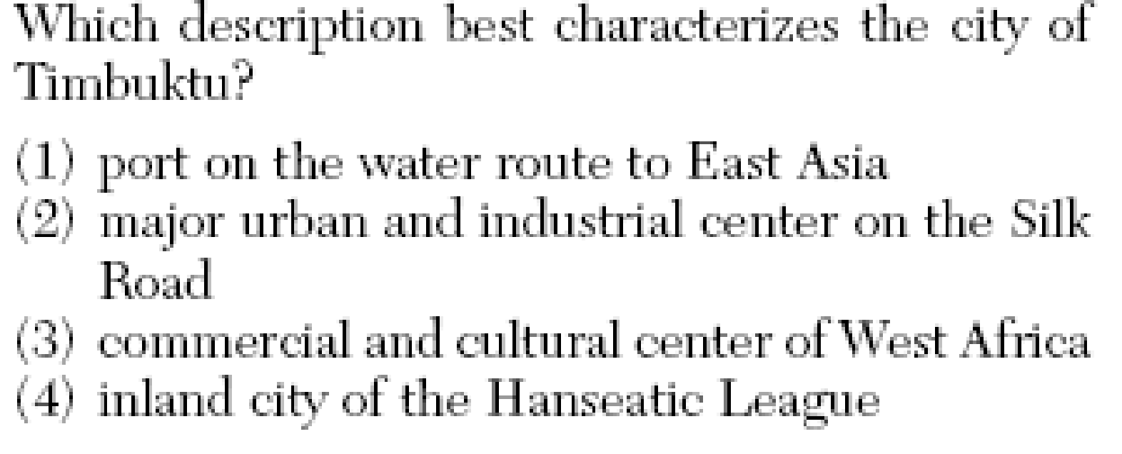
Answer the following question:

Slide 15
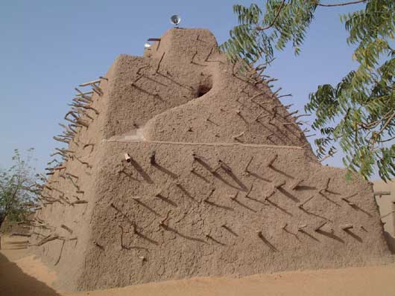
Songhai
The largest of the 3 major West African kingdoms
Took control of Timbuktu
Expanded trade to Europe and Asia
Time of great cultural diffusion
Askia Muhammad sets up high functioning bureaucracy
5 provinces each with
A governor
Tax collector
Judges (Like Mansa Musa, had laws based on Qur’an)
Trade inspectors

Slide 16
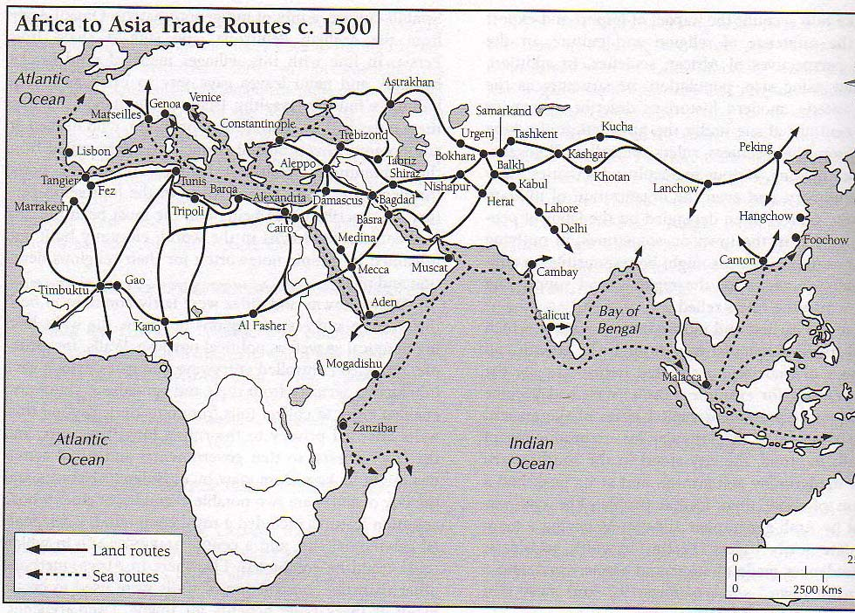

Slide 17
Masks
https://www.ted.com/talks/camille_a_brown_a_visual_history_of_social_dance_in_25_moves

