Slide 1
The Black Death

Slide 2
Bell Ringer: Introduction to the Plague
Using the video and prior knowledge, make a list of what you know about the plague and important ideas from the video (perhaps they’re repeated?)
“The plague is B-U-B-O-N-I-C”

Slide 3
Constructive Response Question
What was the black death and what effects did it have on the people of Europe?

Slide 4
The Black Death
What was the black death?
The black death was a deadly disease that began in Asia and spread through trade routes infecting parts of Asia, the Muslim World and Europe
Also known as the bubonic plague
First arrived in Europe in 1347 on a Genoese merchant ship
The black death got it’s name because of the purplish or blackish spots it produced on the skin

Slide 5
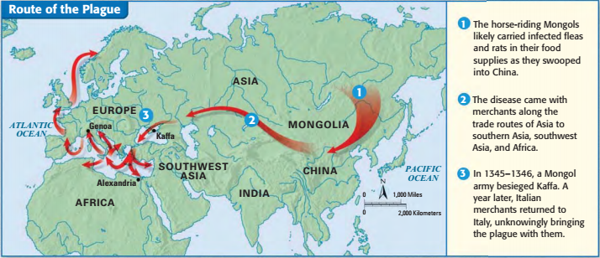
Diffusion (spread) of disease
-Use the map on pg. 400 to answer the following question
1.where did the plague start?

Slide 6
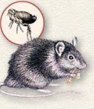
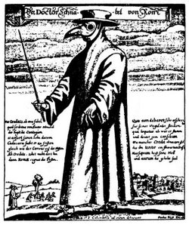
The Black Death
What caused the black death?
Black rats carried fleas that were infested with a bacillus called Yersinia pestis
The disease also traveled from person to person pneumonically, or through the air
Unsanitary conditions and lack of medical knowledge caused the plague to spread with incredible speed
Medieval people threw their garbage and sewage into the streets which became a breeding ground for more rats
Physicians relied on crude and unsophisticated techniques such as bloodletting and boil-lancing

Slide 7
Connect to Today
1. What changes have been made over time that prevent the rapid spread of diseases today?
2. What factors contribute to the spread of disease in modern society?

Slide 8
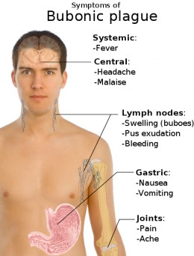
The Black Death
What were the symptoms of the black death?
Painful swellings called buboes in the lymph nodes, particularly those in the armpits and groin
Purplish or blackish spots on the skin
Extremely high fever, chills, delirium, and in most cases death
VIDEO- coroner’s report http://www.history.com/topics/black-death/videos/coroners-report-plague

Slide 9
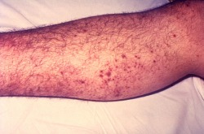
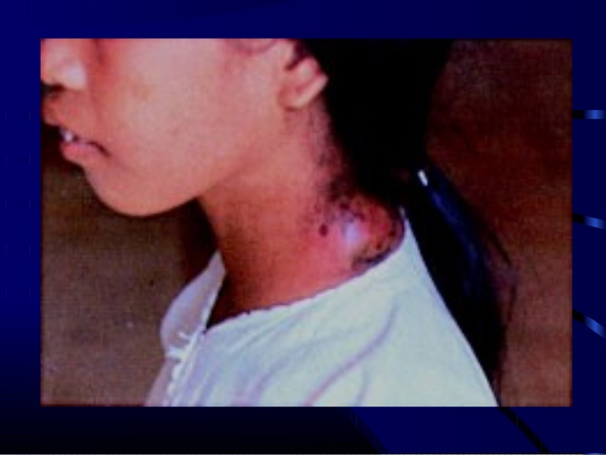
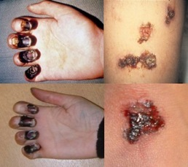
Symptoms of the plague
Make a prediction:
How will the plague affect Europe?

Slide 11
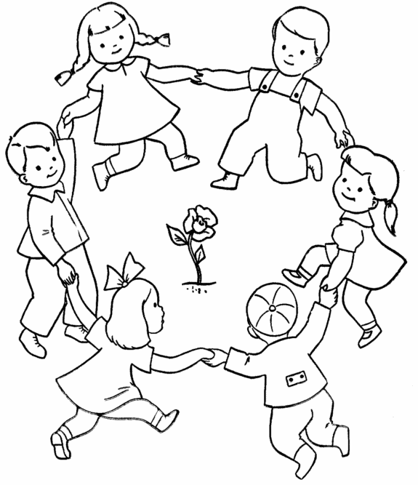
Ring Around the Rosie
Explain the meaning of each line after watching the video.
Ring Around the Rosie=
Pocket full of Posies=
A-tishoo A-tishoo=
We all fall down=
Ring Around the Rosie Video
https://youtu.be/UaspFUkcPjo

Slide 14
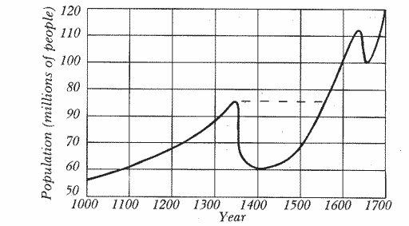
The Black Death
What were the effects of the Black Death?
Town populations fell
Trade declined and prices rose
The Church suffered a loss of prestige when its prayers failed to stop the onslaught of the plague and priests abandoned their duties
Jews were blamed for bringing on the plague
All over Europe, Jews were driven from their homes or, worse, massacred

Slide 15
Primary Source
The mortality in Siena began in May. It was a cruel and horrible thing; and I do not know where to begin to tell of the cruelty and the pitiless ways. It seemed that almost everyone became stupefied by seeing the pain. And it is impossible for the human tongue to recount the awful truth. Indeed, one who did not see such horribleness can be called blessed. And the victims died almost immediately. They would swell beneath the armpits and in the groin and fall over while talking. Father abandoned child, wife husband, one brother another; for this illness seemed to strike through breath and sight. And so they died.And none could be found to bury the dead for money or friendship. Members of a household brought their dead to a ditch as best they could, without priest, without divine offices. Nor did the death bell sound. And in many places in Siena great pits were dug and piled deep with the multitude of dead. And they died by the hundreds both day and night, and all were thrown in those ditches and covered over with earth. And as soon as those ditches were filled more were dug.
Read the excerpt from the Plague in Siena and answer the following questions:
1. How did those not infected with the plague interact with those who were infected?
2. What was done with the bodies of the dead? Was the burial process a religious proceeding?

Slide 16
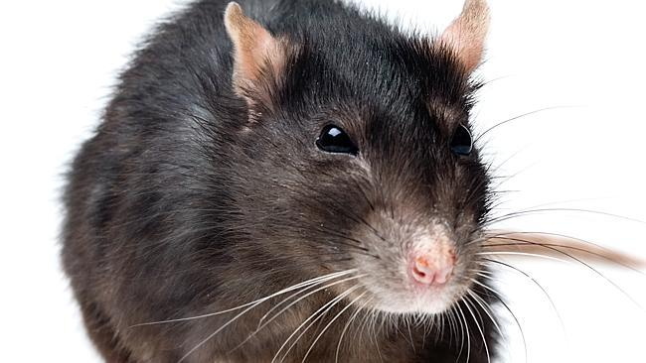
Constructive Response Question:
EXIT TICKET: Before you go….
What was the black death and what effects did it have on the people of Europe?

