Slide 1
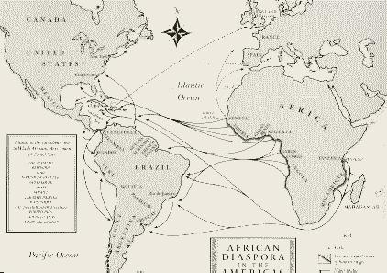
The African Slave Trade

Slide 2
Slave Caravans

Slide 3
Slave Caravans

Slide 4
Slave Ship

Slide 5
The Middle Passage

Slide 6
Slave Revolt

Slide 7
Live slaves thrown overboard

Slide 8
Slave Auctions - Inspections

Slide 9
Slave Auctions

Slide 10
Slave Treatment – cotton fields

Slide 11
Sugar Cane Fields

Slide 12
Housing

Slide 13
Whippings

Slide 14
After Slavery - lynchings

