Slide 1
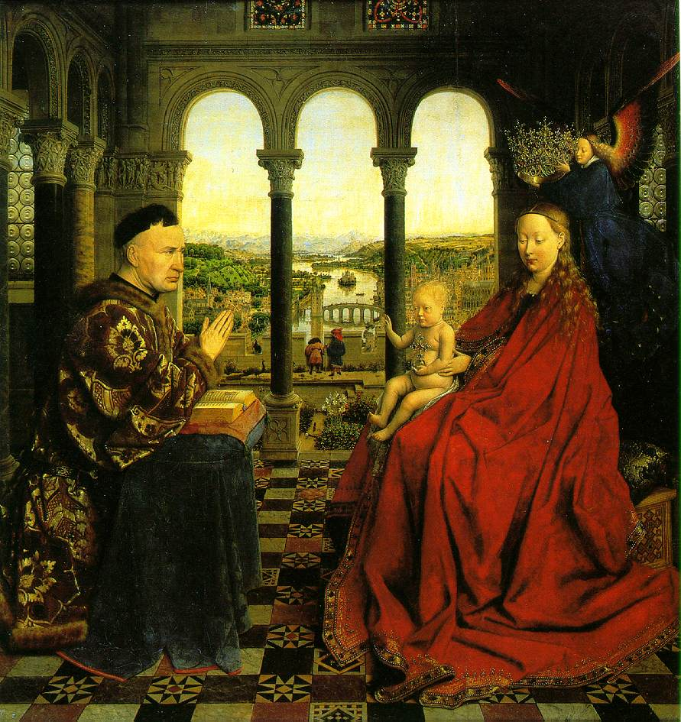
The Renaissance 1300-1600
Definition: A European revival of art and learning inspired by ancient Greece and Rome
Began in Italy and spread throughout Europe
The Madonna of Chancellor Rolin, 1435 by Jan van Eyck

Slide 2
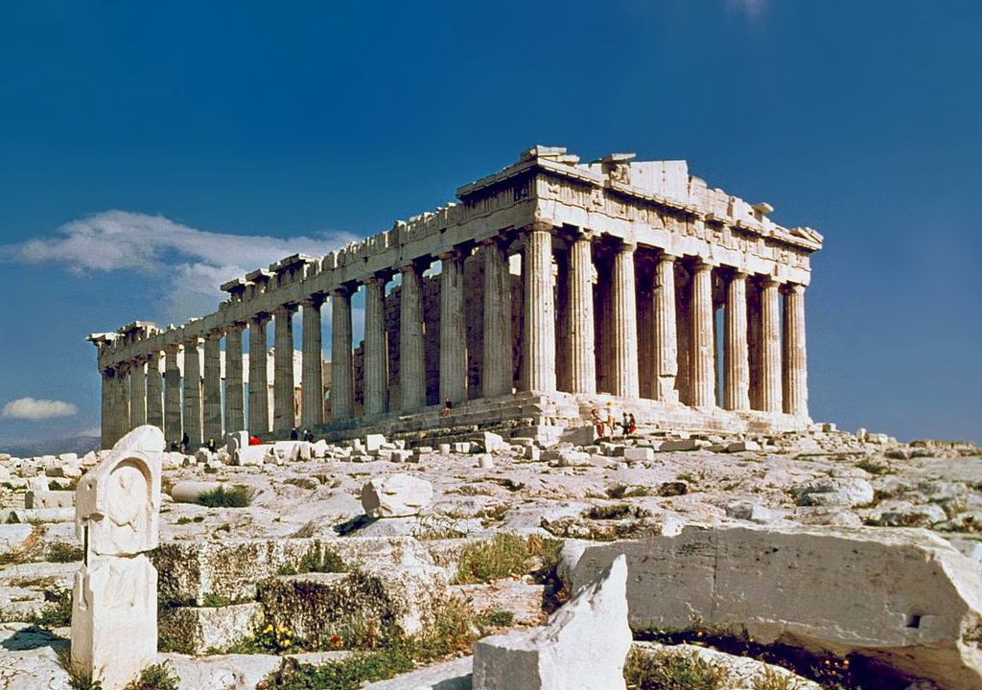
Causes
People began to lose faith in and question the church
-church lost some power
Crusades caused a renewed interest in knowledge
The study of ancient Greece and Rome

Slide 3
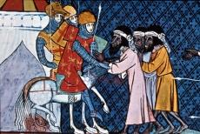
BRAINSTORM
WHY? Using prior knowledge, brainstorm a list of reasons that people began to lose faith in the Church AND why the Crusades increased interest in learning:

Slide 4
Effects
New styles of art and literature
More secular (worldly) society rather than just focusing on religion
Humanism: Focus on human potential and achievement
Emphasis on education
Classical views

Slide 5
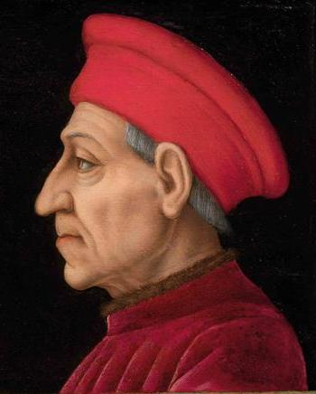
Patron
patron: a financial supporter of the arts
Types of patrons:
church
beautified Rome & other cities
wealthy families
displayed own importance by commissioning portraits and donating art
merchants

Slide 6
Analyzing Primary Sources p. 473
Read the source, The Renaissance Woman and look at the two paintings.
Document Based Question 2: Isabella d’Este’s portrait was painted by Titian, and Castiglione’s by Raphael, two famous painters. What does this tell you about the subjects’ social status?
Critical Thinking Question: How is Isabella d’Este’s relationship with Leonardo da Vinci an example of the the relationship between patrons and artists?

Slide 7
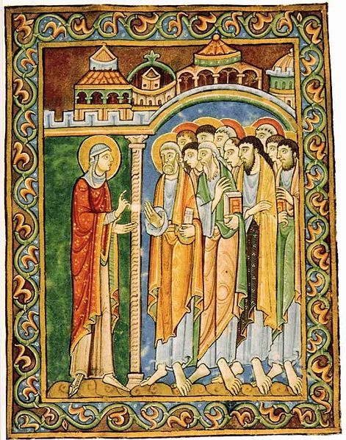
Art during the Middle Ages
religious
dull colors
unrealistic
Mary Magdalene Announcing Resurrection- 1120

Slide 8
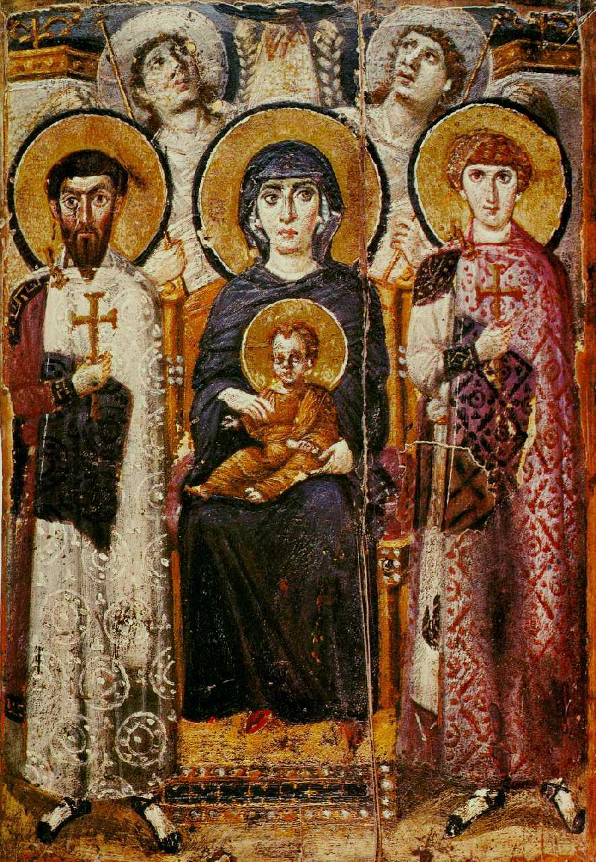
Virgin and Child between Saints Theodore and George, 600

Slide 9
Improvements in Renaissance Art
New Paints Used
Perspective: 3D
Emphasis on beauty, creativity, individual
Painted and sculpted other art besides religious art
Religious art used realistic style
Realistic portraits

Slide 10
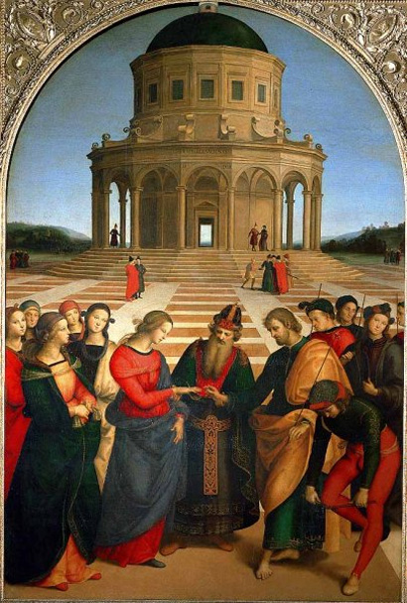
Analyzing Art p. 474
Perspective
Marriage of the Virgin (1504), Raphael
-creates the appearance of three dimensions
-medieval artists abandoned this technique
SKILLBUILDER: Interpreting Visual Sources What is the major difference between the figures in the background of the painting and the figures in the foreground? What is the effect of the difference?

Slide 12
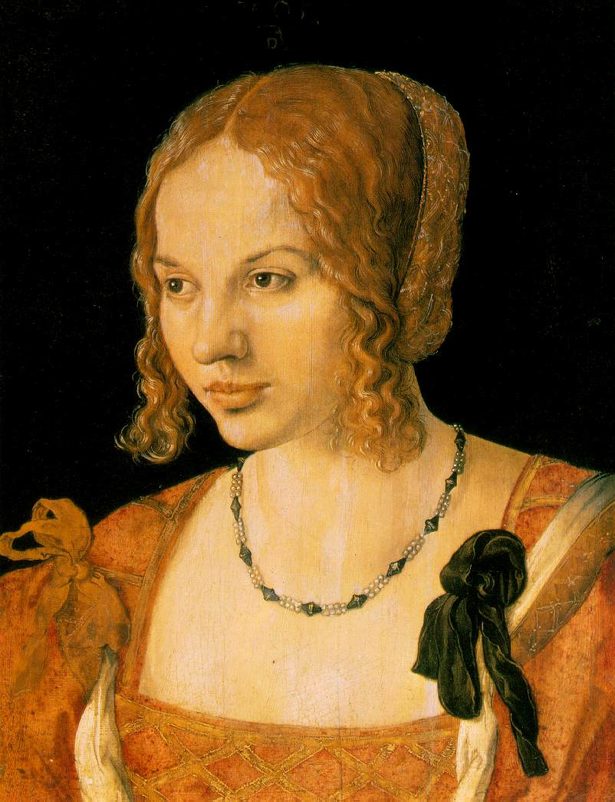
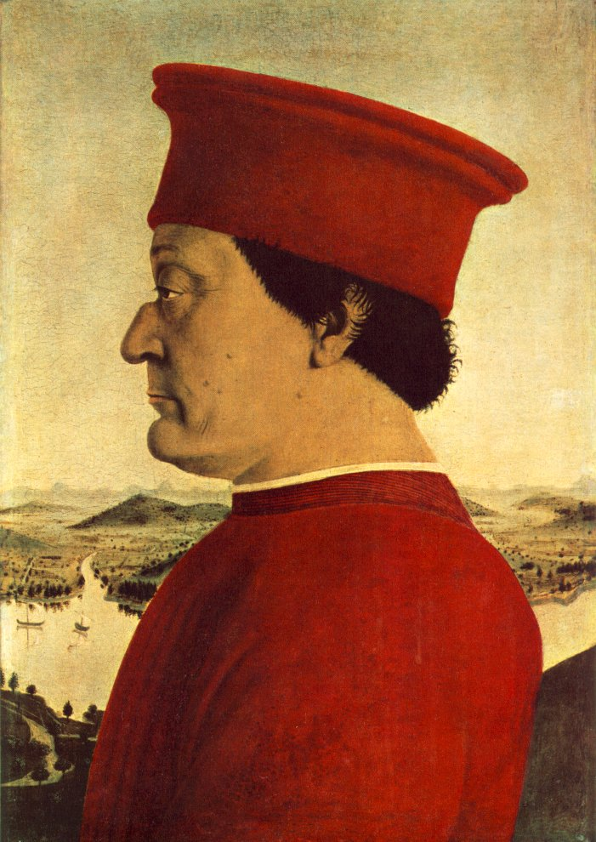
Focus on Individual
Portraits

Slide 13
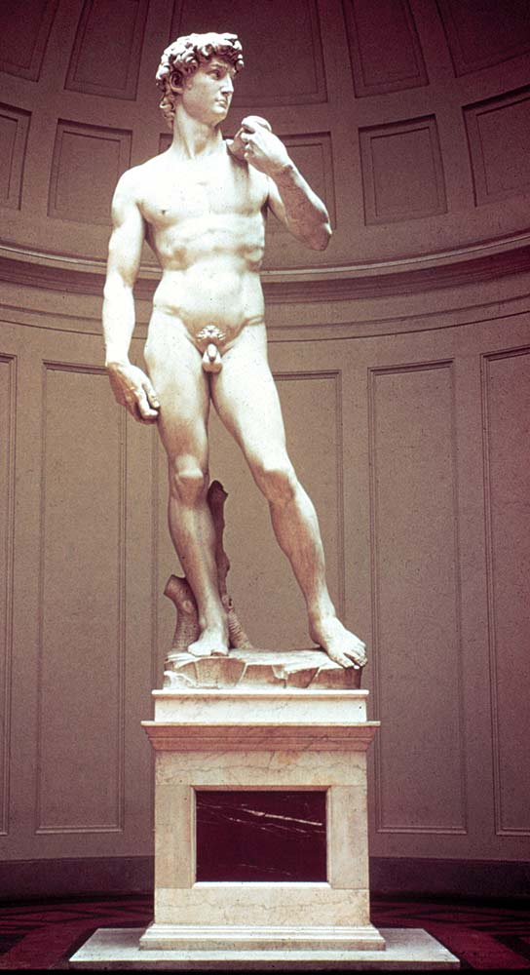
Influence from ancient Greece and Rome
Focus on the beauty of the human body
Focus on individual
David, 1504 by Michelangelo

Slide 14
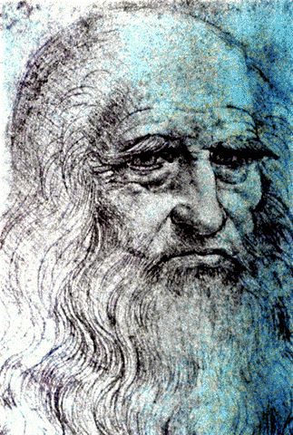
Leonardo Da Vinci
http://www.youtube.com/watch?v=nrV91kOn-ao

Slide 15
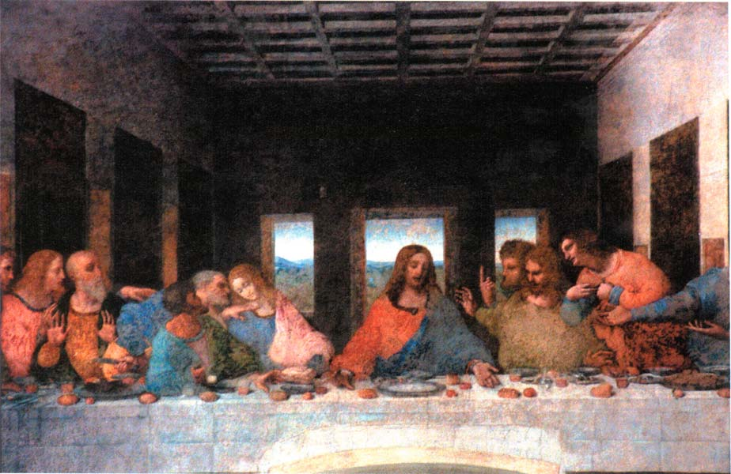
The Last Supper: Da Vinci

Slide 16
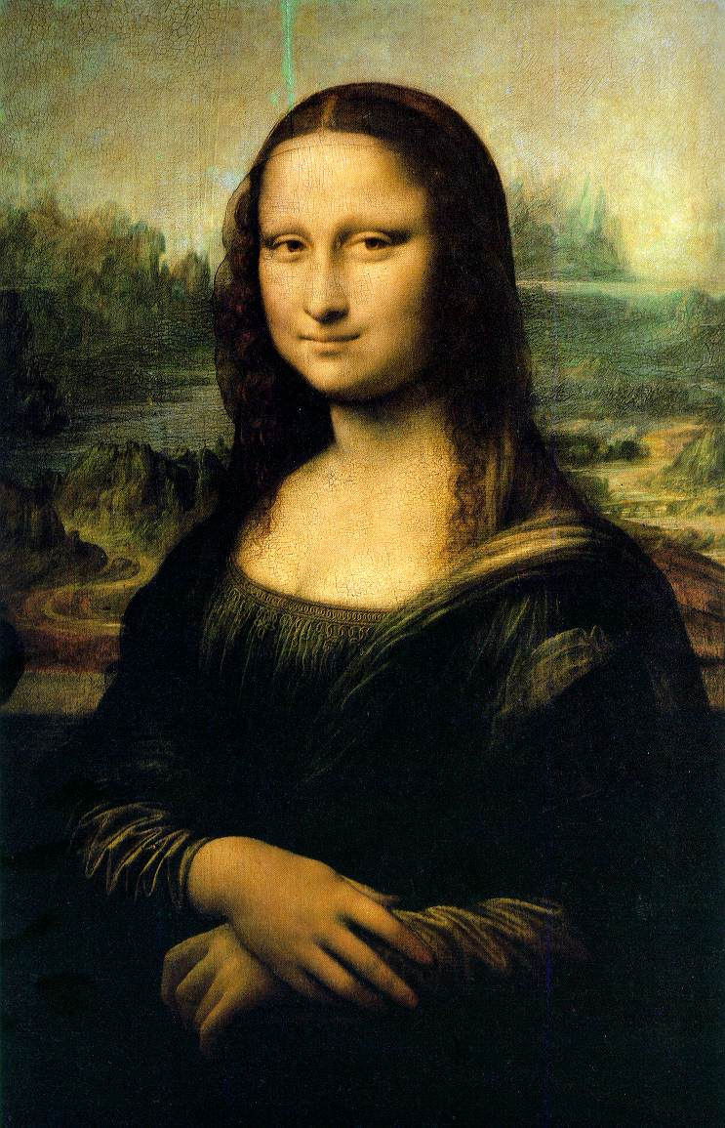
Mona Lisa: Da Vinci

Slide 17
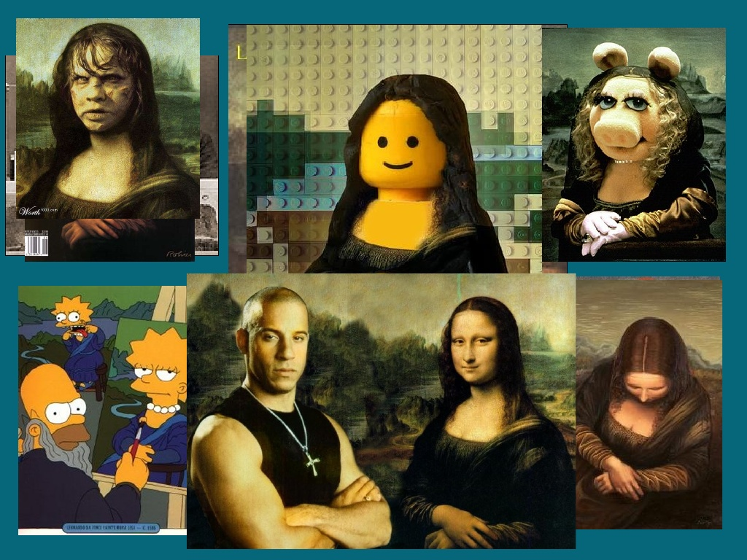

Slide 18
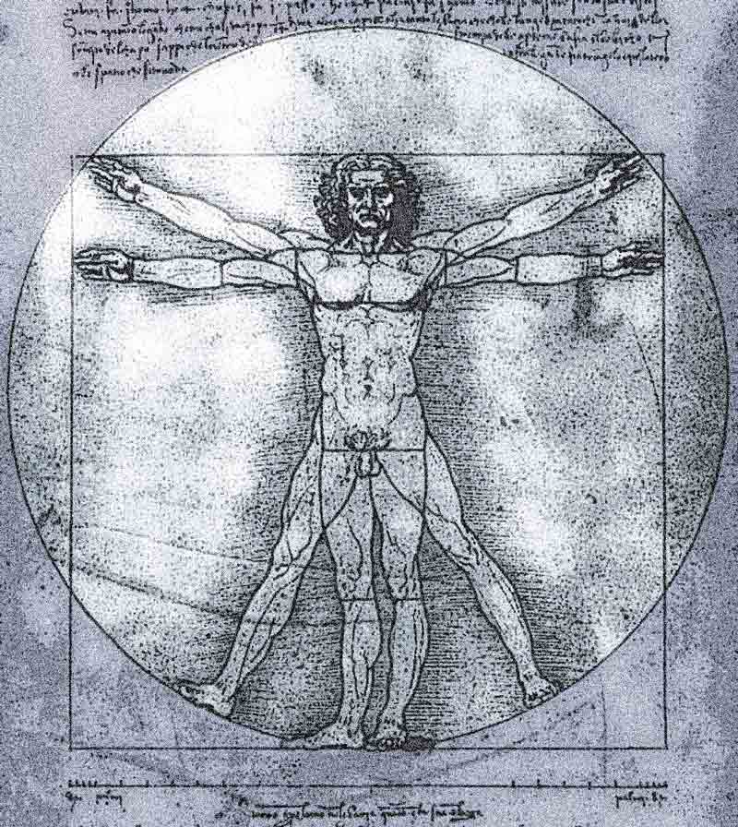
Vitruvian: Da Vinci

Slide 19
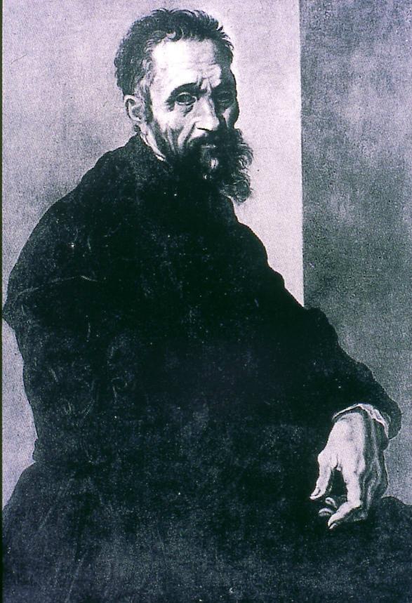
Michelangelo

Slide 20
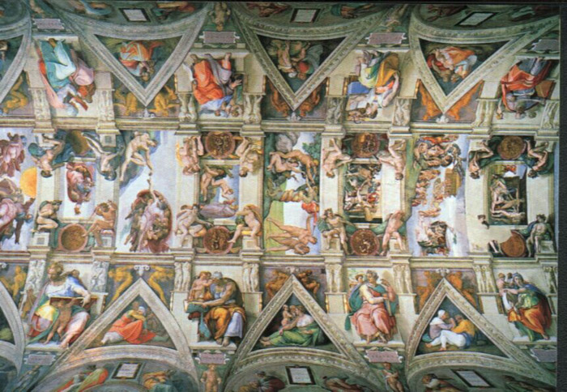
The Sistine Chapel: Michelangelo
Painted on the ceiling of a chapel
All scenes from Bible
Focused on beauty of human body

Slide 21
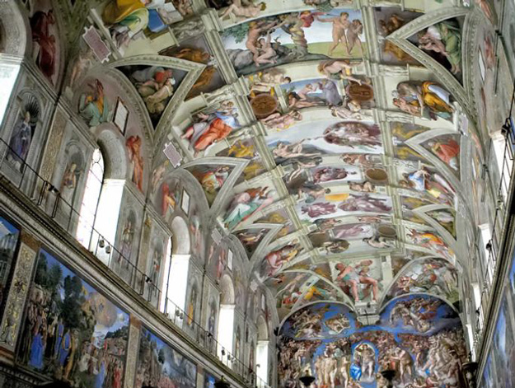

Slide 22
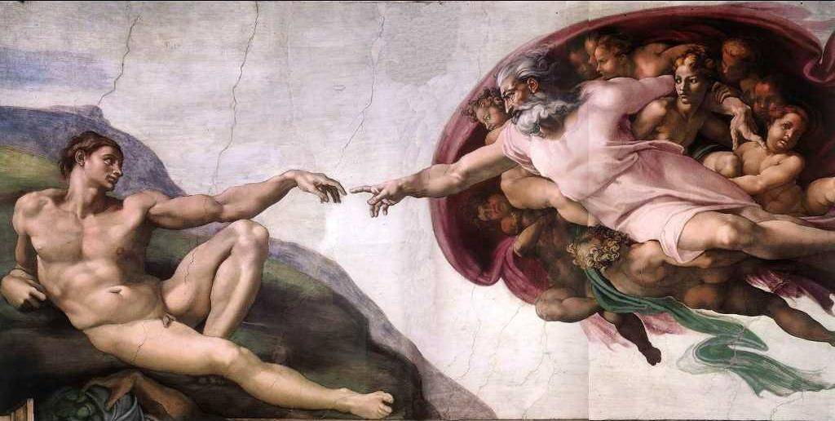
Creation of Man: Sistine Chapel

Slide 23
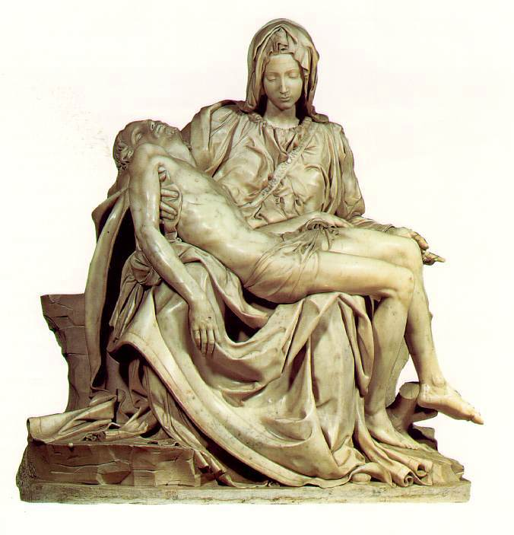
La Pieta: Michelangelo

Slide 24
Improvements in Literature
Authors wrote in the vernacular (native language)
Wrote for self-expression
Wrote to portray individuality of their subjects
Wrote comedies and tragedies

Slide 25
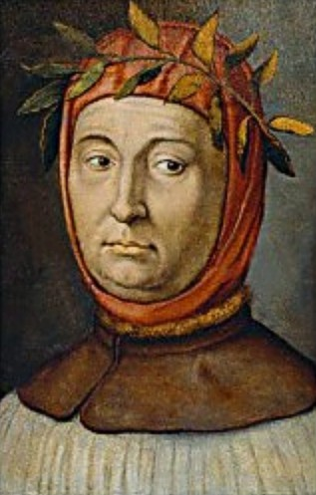
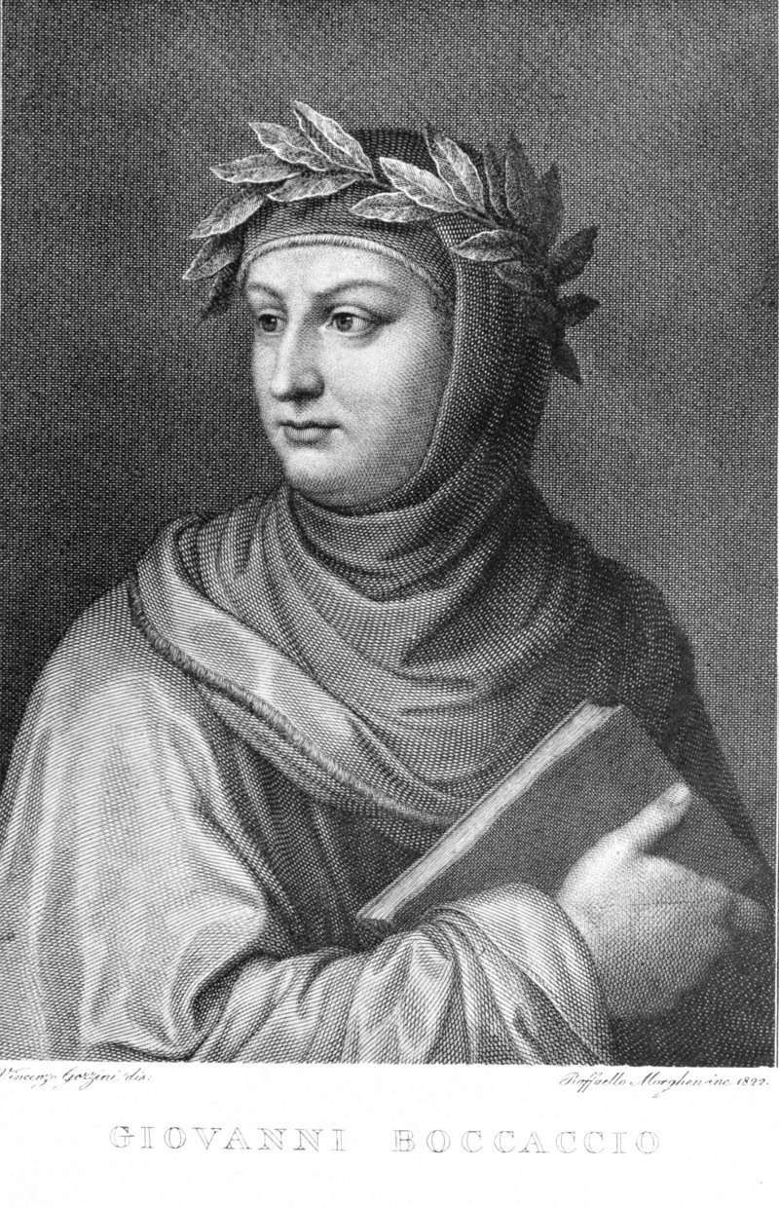
Famous Writers
Petrarch
Boccaccio

Slide 26
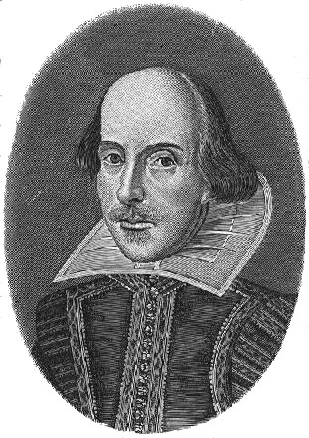
William Shakespeare

Slide 27
Northern Renaissance
Italy was the birthplace of the Renaissance
- These ideas will diffuse (spread) to Northern Europe
-This will lead to more changes
Setting the Stage in Northern Europe
-population bouncing back from plague
-100 Years’ War ends-cities begin to grow
-feudal system breaks down, wealthy merchants emerge in cities
-Urban merchants became patrons of the arts
-starts in Flanders-rich in trade! (Italy)
-England and France had monarchs-they support artists, too
Notes:
in the 1400s, the ideas of the Italian Renaissance began to spread to NORTHERN EUROPE-ideas such as the importance of the individual are a strong part of today’s modern thought. Renaissance ideas such as humanism, classical culture and a curiosity about the world, make an impression on scholars, students and merchants who visited Italy. These ideas spread to Northern Europe-especially England, France, Germany and Flanders (now part of France and the Netherlands)

Slide 28
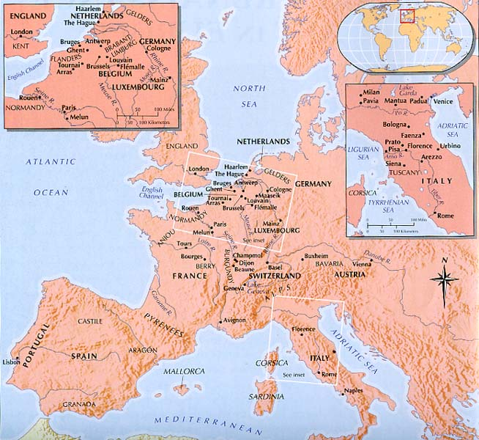
Northern Renaissance
In the 1400s, the ideas of the Italian Renaissance began to spread to NORTHERN EUROPE
-These ideas spread to Northern Europe-especially England, France, Germany and Flanders (now part of France and the Netherlands)

Slide 29
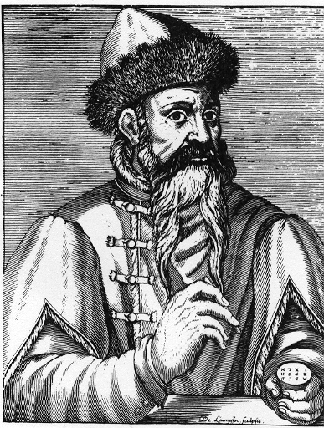
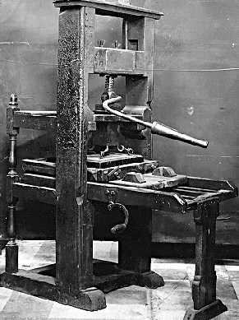
Johann Guttenberg: Printing Press (1450)

Slide 30
Printing Press
History Channel Videos:
The Printing Press
The Printing Press 2

Slide 31
Effects of Printing Press
Made more information available
Inexpensive books made available
Greater availability of books led to increased desire for learning and a rise in literacy throughout Europe

Slide 32
Complete Skillbuilder: Interpreting Graphics Questions 1 & 2 on page 484
Drawing Conclusions: About how many books could a printing press produce in a month?
Making Inferences: Which areas of the world contributed technologies to Gutenberg's printing press?

Slide 33
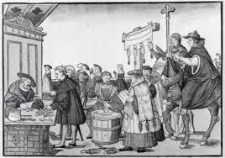
Protestant Reformation
Definition: Religious Reform
Causes
Kings were tired of the pope having too much political power
some viewed the pope as a foreign ruler
Some people felt the church was too interested in worldly things like gaining wealth and political power
Spent money on personal pleasures
Fathered children
Drank or gambled excessively
Selling indulgences (pardon from sins)

Slide 34
Causes of the Reformation
-King jealous of the Church’s wealth
-Merchants didn’t want to pay taxes to the church
-Printing press helped to spread ideas that were critical of the Church’s rule

Slide 35
Effects of Protestant Reformation
A new branch of Christianity was formed
Protestant: Christians who did not belong to the Catholic Church
Lutheran: Followers of Martin Luther
Calvinist: Followers of John Calvin
Anglican: Church of England created by Henry VIII
http://www.youtube.com/watch?v=gi5qR7tflG0
(Reformation)

Slide 36
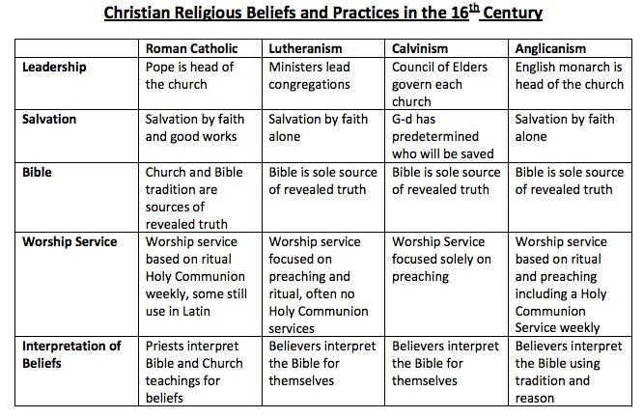
Protestantism p. 491

Slide 37
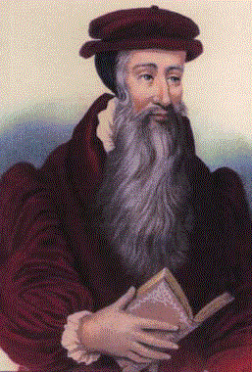
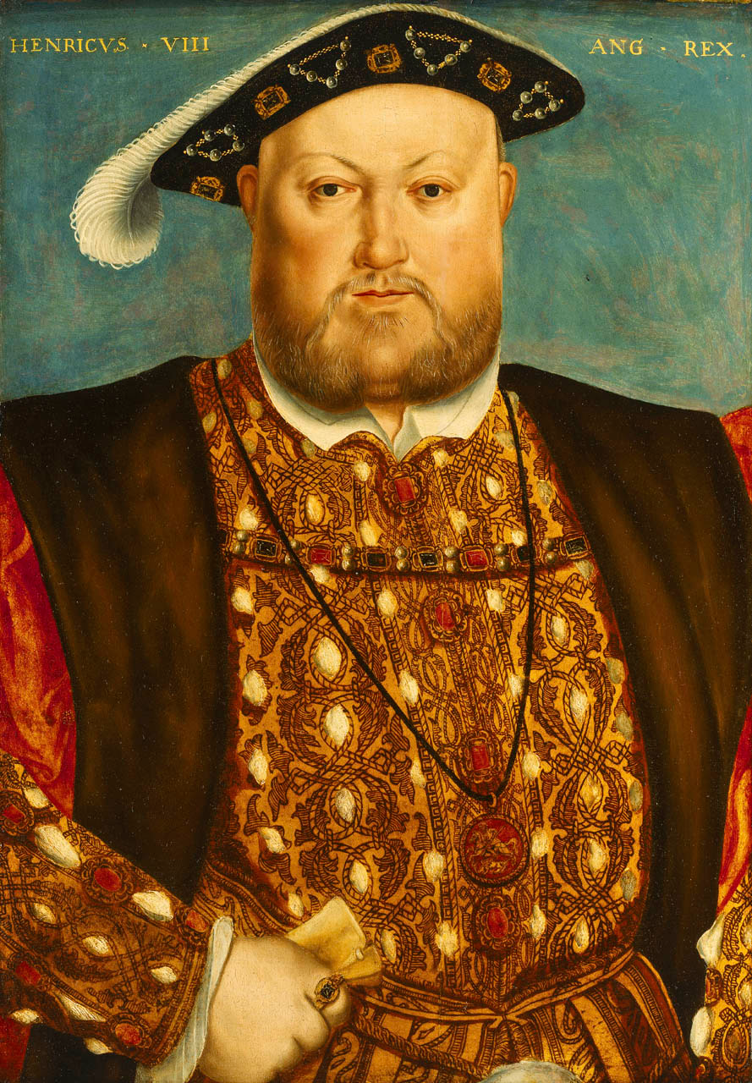
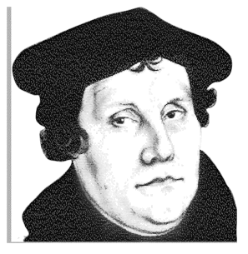
Protestant Reformation
John Calvin
Martin Luther
Henry VIII

Slide 38
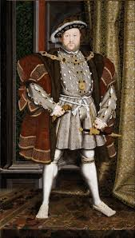
Henry VIII
Use the timeline on pages 492-493 to answer questions about Henry VIII
https://youtu.be/3EGzHsye71c (

Slide 39
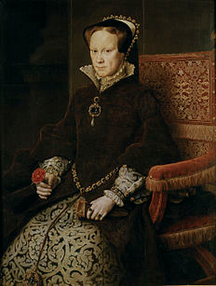
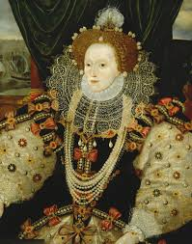
Queens of England
Queen Mary I
Queen Elizabeth I

Slide 40
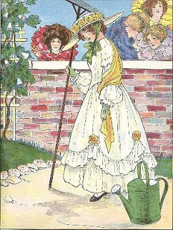
Videos
Mary, Mary quite Contrary
https://www.youtube.com/watch?v=Mn2mJUYYOns
"Mary, Mary, quite contrary,
How does your garden grow?
With silver bells,
And cockle shells,
And pretty maids all in a row"
- Mother Goose Nursery Rhyme

Slide 41
Christian Church Overview
3 Branches of Christianity: Roman Catholic, Eastern Orthodox, Protestantism
The Early Christian Church - Splits in 1054 East and West
East = Eastern Orthodox, West = Roman Catholic
Roman Catholic Church had Protestant Reformation in 16th Century
Three new branches of Protestantism created
Lutheranism
Anglicanism (Church of England) with sub-divisions: • Episcopalian • Baptist • Methodist • Pentecostal
Calvinism with sub-divisions: • Presbyterian • Reformed

