Slide 1
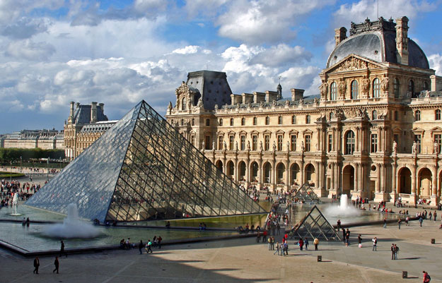
Renaissance Art Museum Tour

Slide 2
The Last Supper by Leonardo da Vinci (1498)

Slide 3
School of Athens by Raphael (1511)

Slide 4
David by Michelangelo (1504)

Slide 5
Marriage of the Virgin by Raphael (1504)

Slide 6
David by Donatello (1440s)

Slide 7
The Equestrian Statue of Gattamelata by Donatello (1453)

Slide 8
Arnolfini Portrait by Jan Van Eyck (1434)

Slide 9
Ceiling of the Sistine Chapel by Michelangelo (1512)

Slide 10
Another look…

Slide 11
The Mona Lisa by Leonardo da Vinci ( )

Slide 12
The Birth of Venus by Botticelli (1485)

