Slide 1
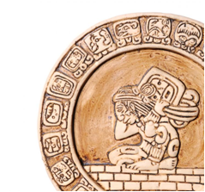
MESOAMERICA
The Maya

Slide 2
CONSTRUCTIVE RESPONSE QUESTION
Who were the Maya and what did they do?

Slide 3
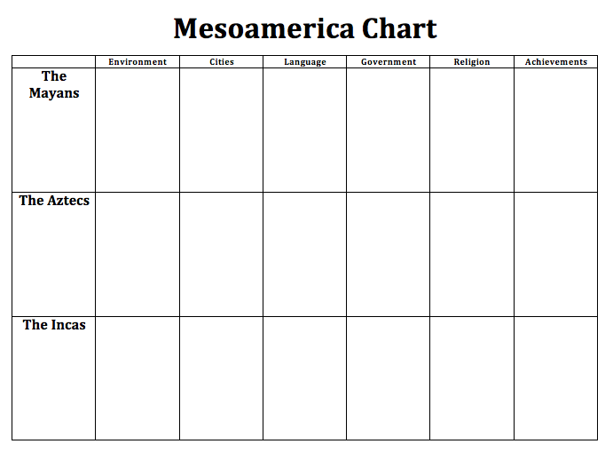

Slide 4
WHAT WILL WE LEARN?
Environment
Cities
Economy
Government
Religion
Achievement
Decline

Slide 5
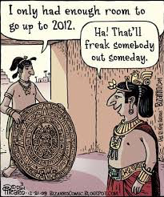
PEAK OF MAYAN CIVILIZATION
Between 250-900 AD

Slide 6
Complete the Geography Skillbuilder on page 447 on a separate sheet of paper that you attach to your notechart
1. Which civilization occupied the Yucatan Peninsula?
2. What other civilization areas were eventually incorporated into the Aztec area?

Slide 7
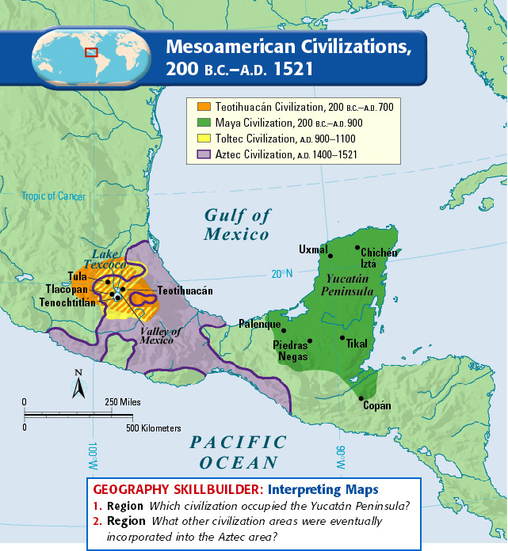

Slide 8
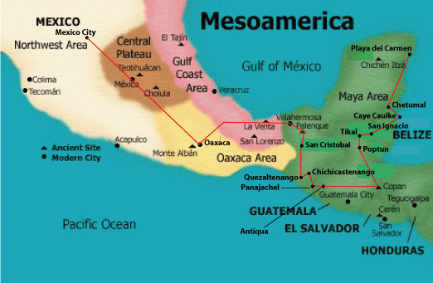
MESOAMERICA

Slide 9
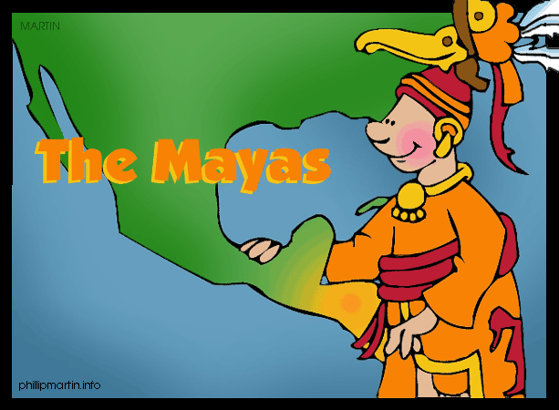
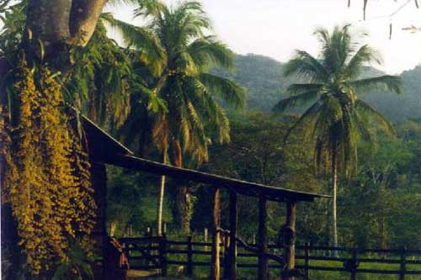
THE MAYAS
Environment
Southern Mexico
Yucatan Peninsula
lowlands- steamy jungles
mountains/highlands-cool
dry forests

Slide 10
MAYA CITIES

Slide 11
THE MAYAS
Cities
Tikal
Palenque
Chichen Itza
Notes:
linked by trade, tens of thousands of people, independent city-states

Slide 12
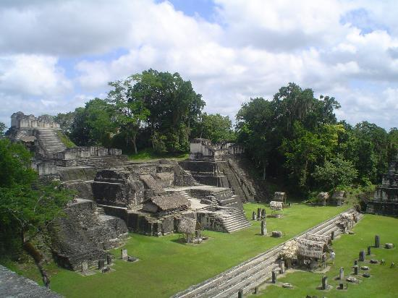
TIKAL

Slide 13
CHICHEN ITZA

Slide 14
PALENQUE

Slide 15
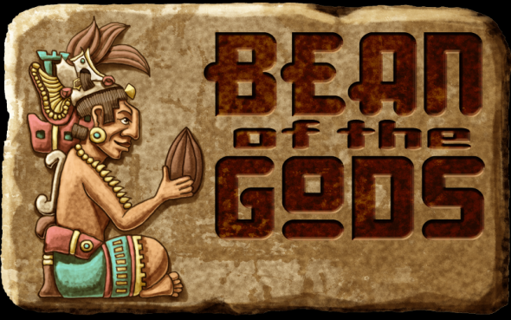
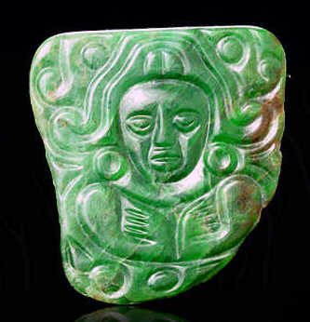
THE MAYAS
Economy
Cities were linked by trade:
Salt, flint, feathers, shells, & honey
cotton textiles (fabric), jade ornaments and chocolate
Jade ornaments
Cacao beans used as currency

Slide 16
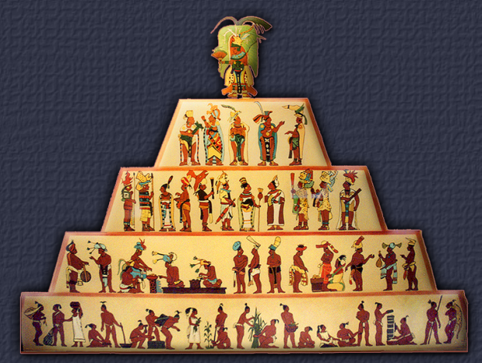
THE MAYAS
Government
Rule by god-kings (theocracy)
Had city-states
Dynasties were important
Noble class near the top

Slide 17
THE MAYAS
Religion
Polytheistic
Blood offerings
Human sacrifice

Slide 18
HUMAN SACRIFICE

Slide 19
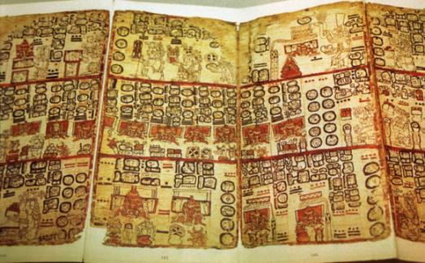
THE MAYAS
Achievements
Most advanced writing system in Americas
800 glyphs
Codex- records (only 3 exist today)

Slide 20
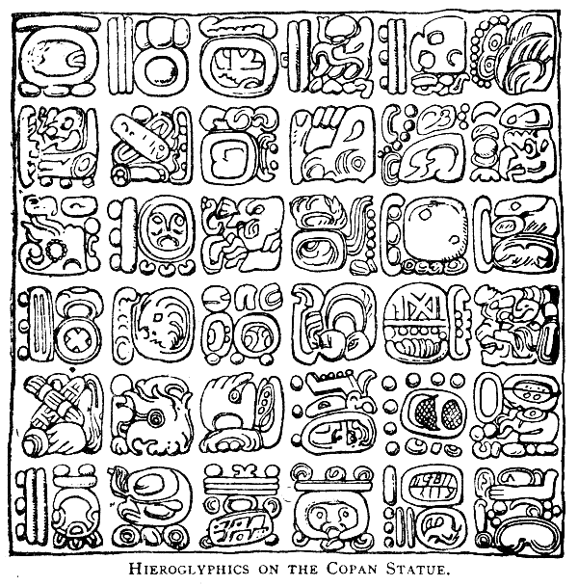
MAYAN GLYPHS

Slide 21
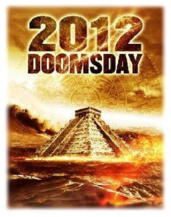
THE MAYAS
Achievements
Calendar System
.002% short of our calendar
2012??
Temple IV
212 feet high
No iron tools or wheels

Slide 22
Let’s read page 450-451 together!
Complete the connect to today, questions 1 & 2, page 451 on the sheet connected to your notechart

Slide 23
Can

Slide 24
The Ball Game
Possibly the earliest organized ball game in history originated with the Olmec
Goal is to get rubber ball through opponents hoop by using only certain parts of body (no hands or feet; only head, hips, elbows, and knees)
Winners were sacrificed depending on civilization
Sometime humans skulls were put inside the ball

Slide 25
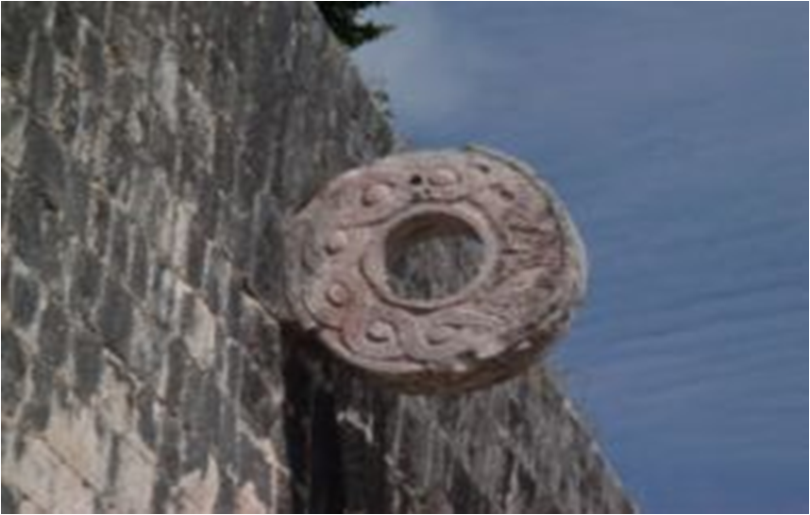

Slide 26
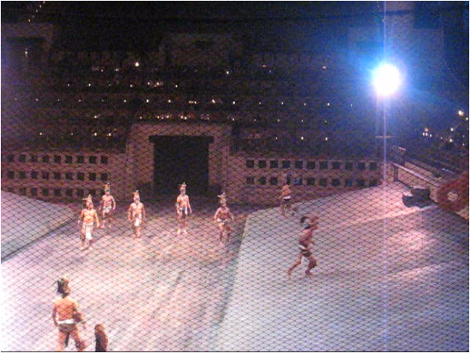
http://www.youtube.com/watch?v=2T5Xjei8-CE

Slide 27
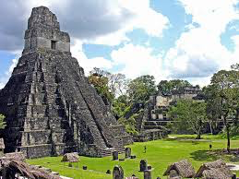
DECLINE
Decline: a mystery!
Environmental constraint causing political and social unrest?
Invasions?
Malnutrition?

Slide 28
CONSTRUCTIVE RESPONSE QUESTION
Who were the Maya and what did they do?
Answer this question in your own words on the sheet connected to your notechart

