Slide 1
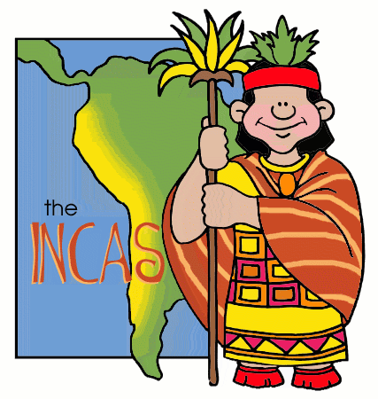
Mesoamerica
The Incas

Slide 2
Constructive Response Question
Who were the Incas and what did they do?

Slide 3
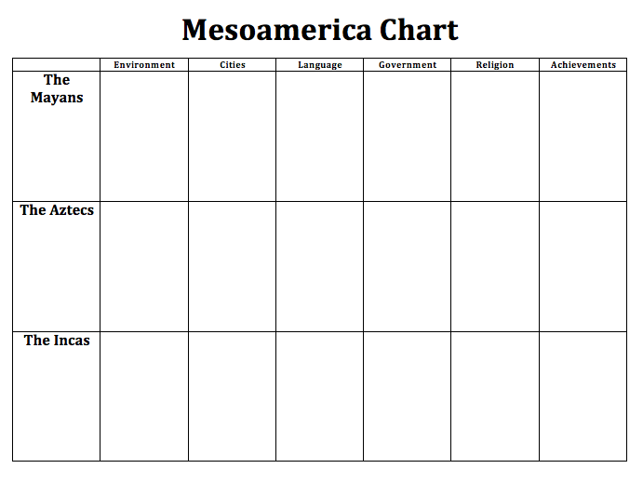

Slide 4
What Will we learn?
Environment
Cities
Economy
Government
Religion
Achievements
Decline

Slide 6
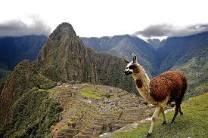
Height of Incan Empire
1438-1533 AD

Slide 7
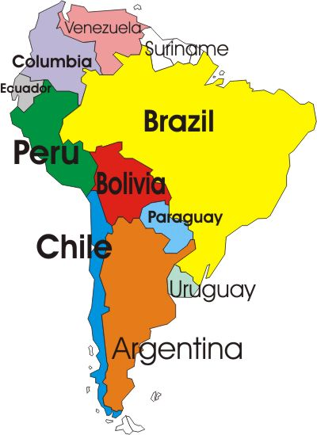
The Incas
Environment
South America
Peru
Andes Valley of Cuzco
Ecuador to Chile

Slide 8
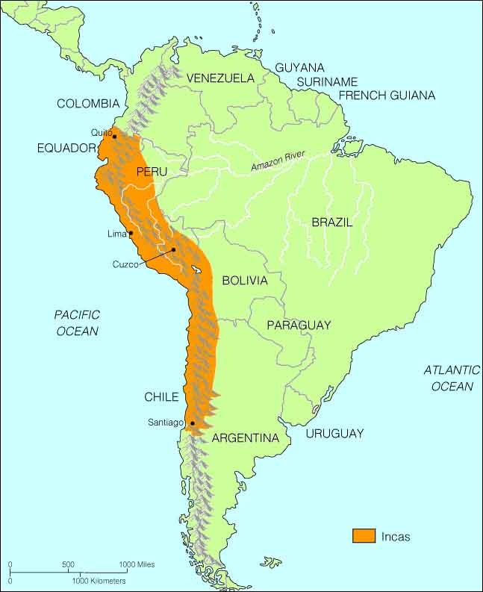
Notes:
orange= Inca Empire

Slide 9
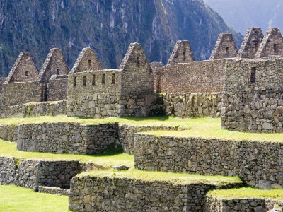
The Incas
Cities
Cuzco
All roads lead to Cuzco
Heart of the Incan Empire
Machu Picchu
Sun temple, central plaza, public buildings

Slide 10
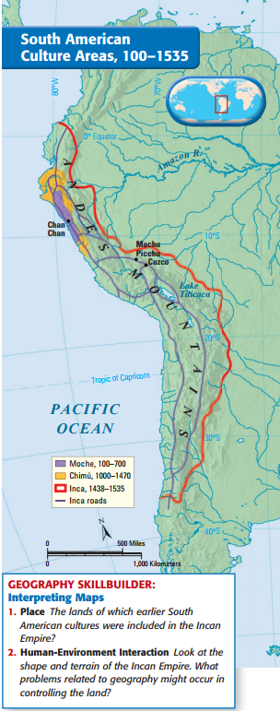
Complete Geography Skillbuilder on page 461 on the sheet connected to your notechart
1. The lands of which earlier South American cultures were included in the Incan Empire?
2. Look at the shape and terrain of the Incan Empire? What problems related to geography might occur in controlling the land?

Slide 11
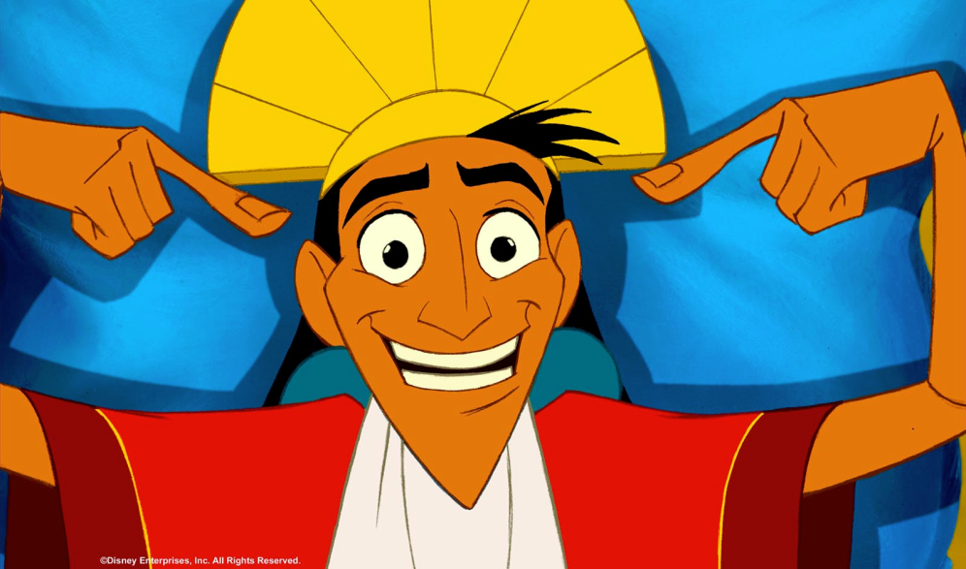
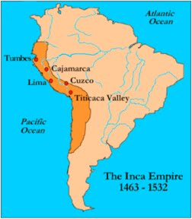
Cuzco

Slide 12
Machu Picchu

Slide 13
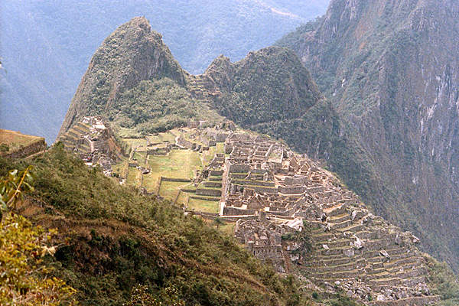
Machu Picchu

Slide 14
The Incas
Economy
Run by the government
Ayllu, or extended family group:
Organized into groups of 10, 100, 1000, & 10,000
Built irrigation canals
Terrace farming
Stored/distributed food

Slide 15
The Incas
Government
Belief that Incan ruler was descended from sun god
Total control over economic & social life
Divided territory into smaller, manageable units (ayllu)
Built cities & schools in conquered areas

Slide 16
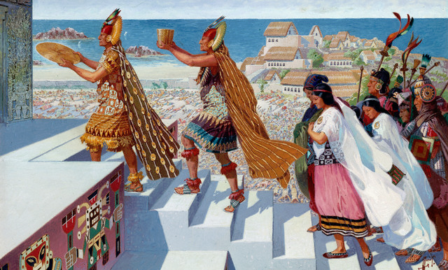
The Incas
Religion
Few key nature spirits
Creator God: Viracocha
Sun God: Inti
Unmarried young men & women sometimes used for lifetime of religious service

Slide 17
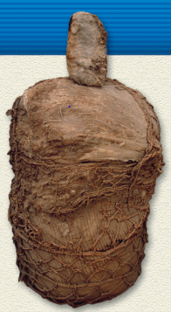
Incan Mummies: Complete Connect to Today question 1 on pg 465 on the sheet connected to your notechart
1. What do Incan mummification practices suggest about Incan culture?

Slide 18
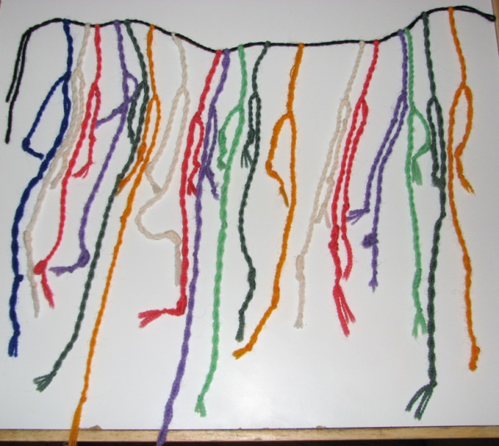
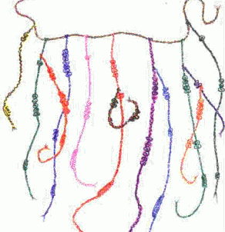
The Incas
Achievements
Quechua: official spoken language to unite other people Inca conquered
No written language
Quipu were used for government record keeping

Slide 19
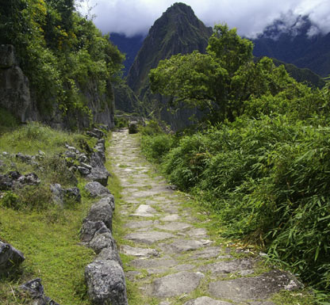
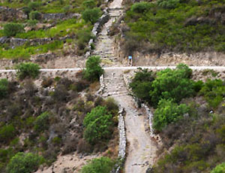
The Incas
Achievements
No iron tools or the wheel
Road system was 14,000 miles long- why?
Runners were used like a postal system
Notes:
road system-LONG huge empire, need MANY roads to connect all cities and parts of empire
advantages: accessibility
disadvantages: come back to bite them in the butt when the Spanish arrive

Slide 20
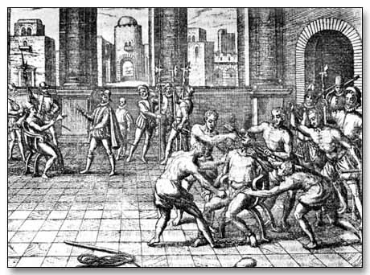
Fall of the Incas
Civil war between brothers weakened empire
War left Incan empire vulnerable to Spanish conquest
Death of Atahualpa

Slide 22
Constructive Response Question
Who were the Incas and what did they do?
Answer this question in your own words on the sheet connected to your notechart

