Slide 1
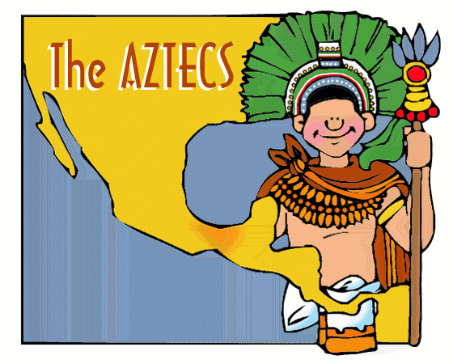
Mesoamerica
The Aztecs

Slide 2
Constructive Response Question
Who were the Aztecs and what did they do?

Slide 3
What Will we learn?
Environment
Cities
Economy
Government
Religion
Achievements
Decline

Slide 4
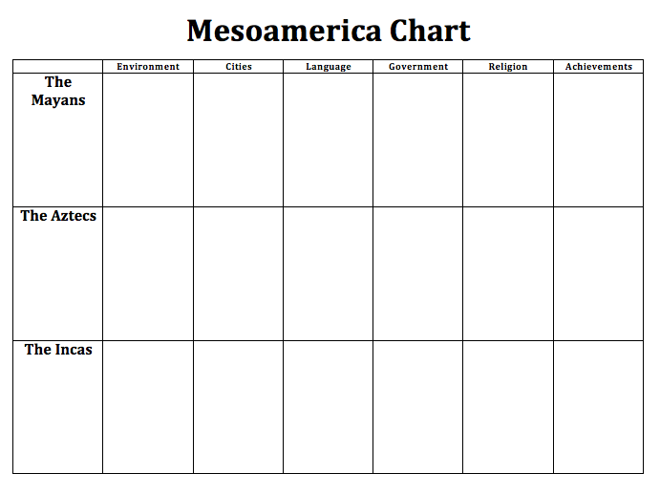

Slide 5
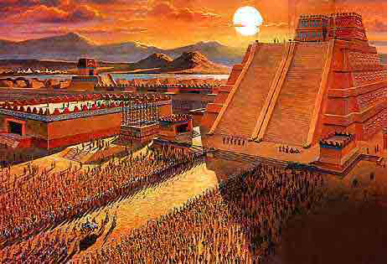
Peak of Aztec Power
Roughly 1325-1521

Slide 6
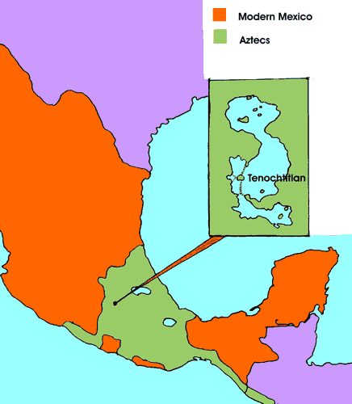
The Aztecs

Slide 7
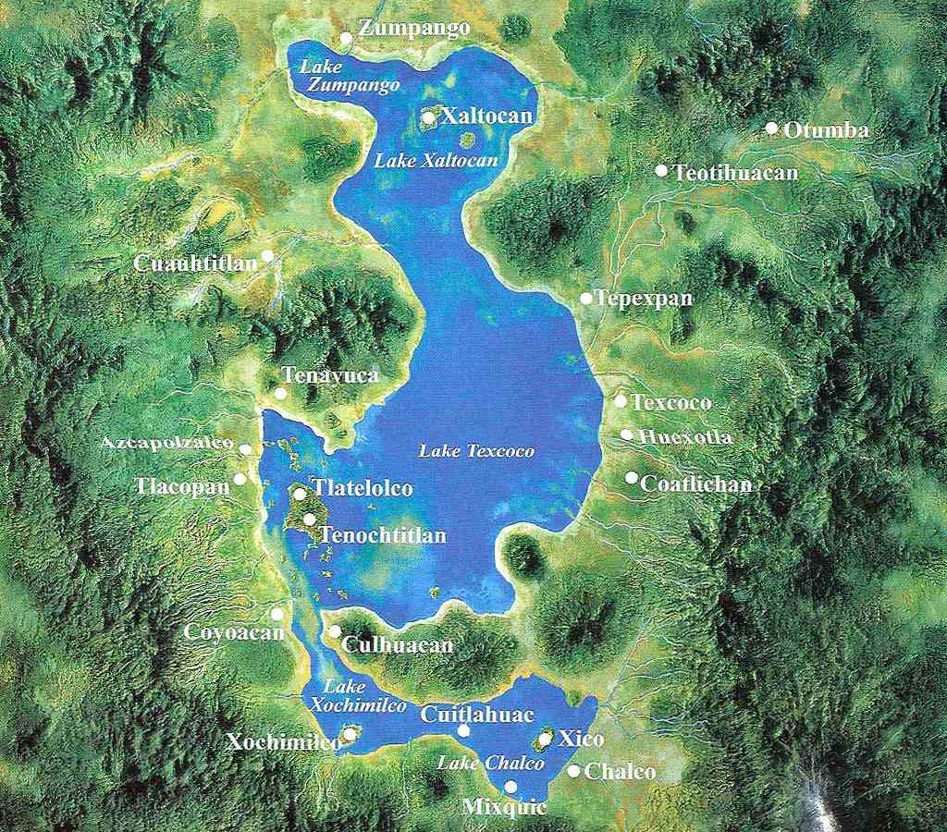
The Aztecs
Environment
Valley of Mexico
7,500 ft above sea level
Fertile soil
Several shallow lakes
Lake Texcoco
Notes:
nomads who move into the area from deserts of northern Mexico

Slide 8
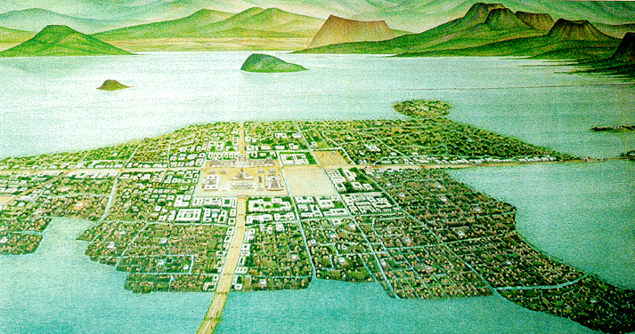
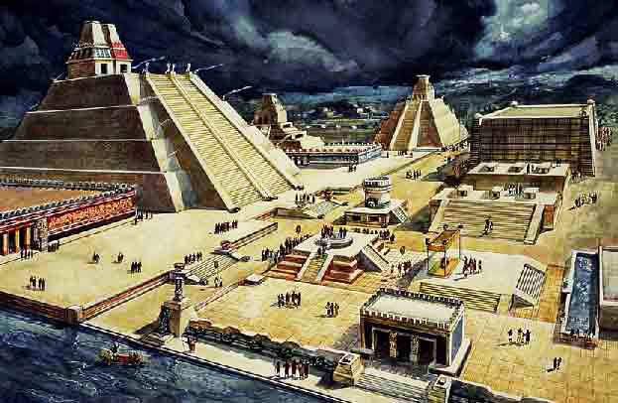
The Aztecs
Cities
Tenochtitlan
Teotihuacan

Slide 9
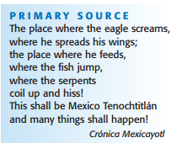
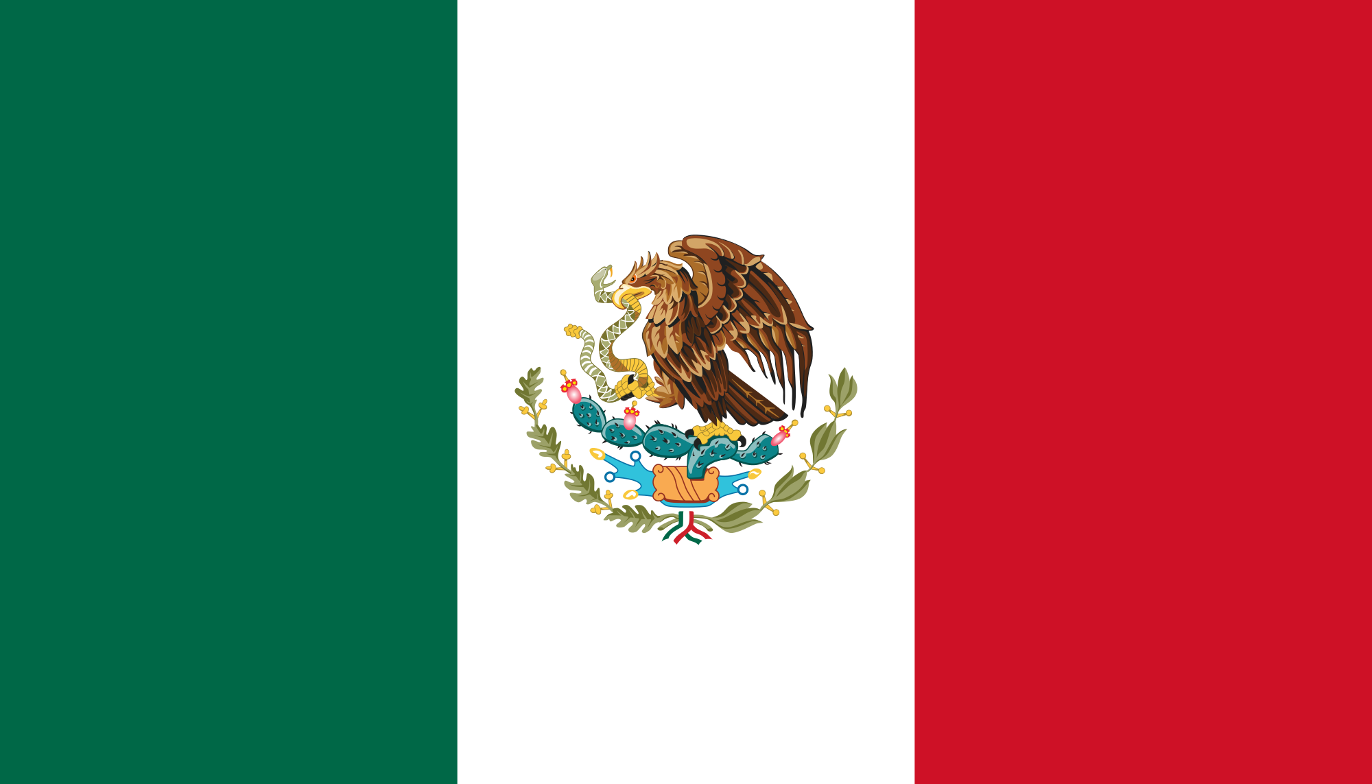
Read the primary source on pg 454 and answer the following question on the sheet connected to your notechart
1. How is this primary source connected to the Mexican flag?

Slide 10
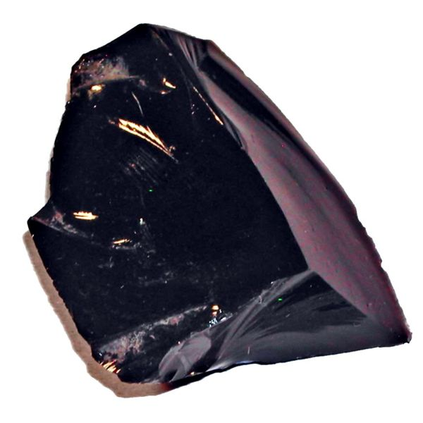
The Aztecs
Economy
Demanded tribute from those they conquered
Traded Obsidian
Notes:
The Aztecs generally exercised loose control over the empire, often letting local rulers govern their own regions. The Aztecs did demand tribute, however, in the form of gold, maize, cacao beans, cotton, jade, and other products. If local rulers failed to pay tribute, or offered any other kind of resistance, the Aztecs responded brutally. They destroyed the rebellious villages and captured or slaughtered the inhabitants.

Slide 11
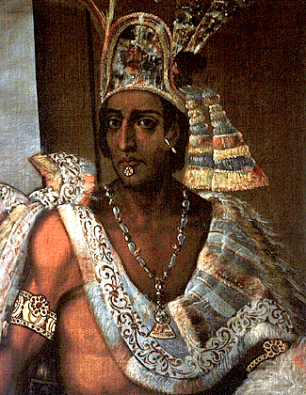
The Aztecs
Government
Created Triple Alliance with:
Texcoco
Tlacopan
Emperor at the top – absolute power
Power weakens under Montezuma
Notes:
Tlacopan—to form the Triple Alliance. This alliance became the leading power in the Valley of Mexico and soon gained control over neighboring regions. By the early 1500s, the alliance controlled a vast empire that covered some 80,000 square miles stretching from central Mexico to the Atlantic and Pacific coasts and south into Oaxaca. This empire was divided into 38 provinces. It had an estimated population of between 5 and 15 million people

Slide 12
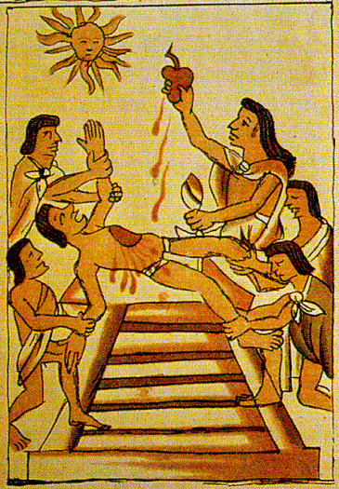
The Aztecs
Religion
Polytheistic – over 1,000 gods
Offerings to the gods:
Dramas
Songs
Dances
Sacrifice to the Sun God- cut out human hearts
Notes:
Religion played a major role in Aztec society. Tenochtitlán contained hundreds of temples and religious structures dedicated to the approximately 1,000 gods that the Aztecs worshiped. The Aztecs adopted many of these gods, and religious practices related to them, from other Mesoamerican peoples. For example, the Aztecs worshiped the Toltec god Quetzalcoatl in many forms. They saw him as the god of learning and books, the god of the wind, and a symbol of death and rebirth. The Aztecs pictured Quetzalcoatl not only as a feathered serpent, but also as a paleskinned man with a beard.
Religious Practices Aztec religious practices centered on elaborate public ceremonies designed to communicate with the gods and win their favor. At these ceremonies, priests made offerings to the gods and presented ritual dramas, songs, and dances featuring masked performers. The Aztec ceremonial calendar was full of religious festivals, which varied according to the god being honored.
Sacrifices for the Sun God The most important rituals involved a sun god, Huitzilopochtli. According to Aztec belief, Huitzilopochtli made the sun rise every day. When the sun set, he had to battle the forces of evil to get to the next day. To make sure that he was strong enough for this ordeal, he needed the nourishment of human blood. Without regular offerings of human blood, Huitzilopochtli would be too weak to fight. The sun would not rise, the world would be plunged into darkness, and all life would perish. For this reason, Aztec priests practiced human sacrifice on a massive scale. Each year, thousands of victims were led to the altar atop the Great Temple, where priests carved out their hearts using obsidian knives. Sacrificial victims included enslaved persons, criminals, and people offered as tribute by conquered provinces. Prisoners of war, however, were the preferred victims. As a result, the priests required a steady supply of war captives. This in turn pushed the Aztec military to carry out new conquests. In fact, the Aztecs often went to war not to conquer new lands, but simply to capture prisoners for sacrifice. They even adapted their battle tactics to ensure that they took their opponents alive.

Slide 13
The Aztecs
Achievements
Pictographs or glyphs
Not a complete writing system that can communicate all things
Notes:
The Aztec Calendar The Aztec system of tracking the days was very intricate. Archaeologists believe that the Aztec calendar system was derived from the Maya system. The Aztecs followed two main calendars: a sacred one with 13 months of 20 days and an agricultural or solar one with 18 months of 20 days. (Notice that this comes to 360 days. The Aztecs then had an unlucky five-day period known as nemontemi, making their solar calendar 365 days long.) Every 52 years, the two calendars would start on the same day, and a great ceremony of fire marked the occasion.
Aztec Sunstone Originally located in the main ceremonial plaza of Tenochtitlán, the Aztec calendar stone measures 13 feet in diameter and weighs 24 tons. It was uncovered in Mexico City in 1790. The Sunstone, as it is called, contains a wealth of information about the days that began and ended the Aztec months, the gods associated with the days, and many other details. Aztec Gods The Aztecs worshiped many different gods. They were a vital part of the Aztec calendar and daily life. The Aztecs paid tribute to different gods depending, in part, on the day, week, month, year, and religious cycle of the Aztec calendars. The god shown here is a sun god, Tonatiuh. The Aztec Calendar The Aztec system of tracking the days was very intricate. Archaeologists believe that the Aztec calendar system was derived from the Maya system. The Aztecs followed two main calendars: a sacred one with 13 months of 20 days and an agricultural or solar one with 18 months of 20 days. (Notice that this comes to 360 days. The Aztecs then had an unlucky five-day period known as nemontemi, making their solar calendar 365 days long.) Every 52 years, the two calendars would start on the same day, and a great ceremony of fire marked the occasion. SKILLBUILDER: Interpreting Visual Sources

Slide 14
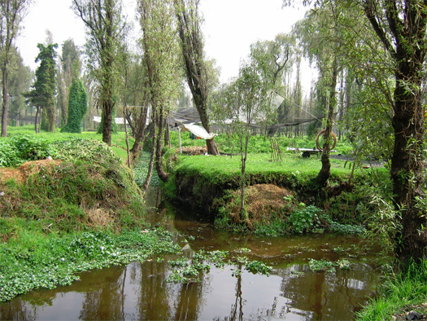
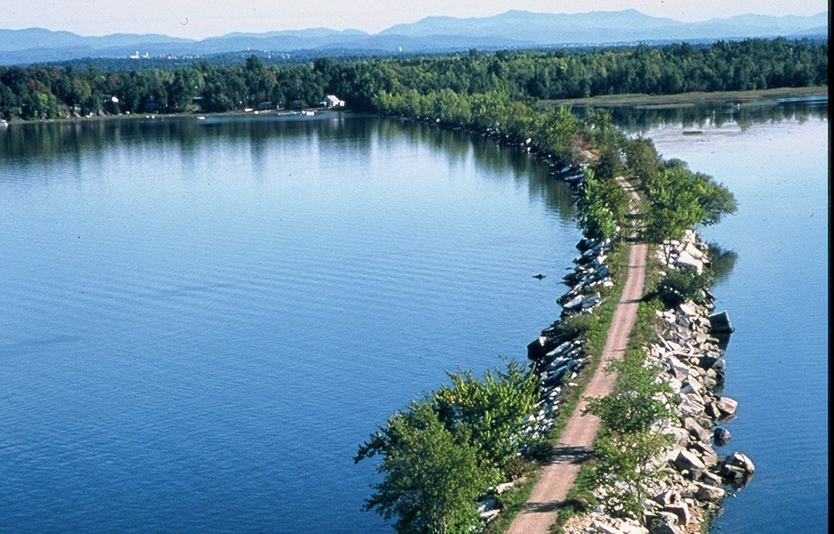
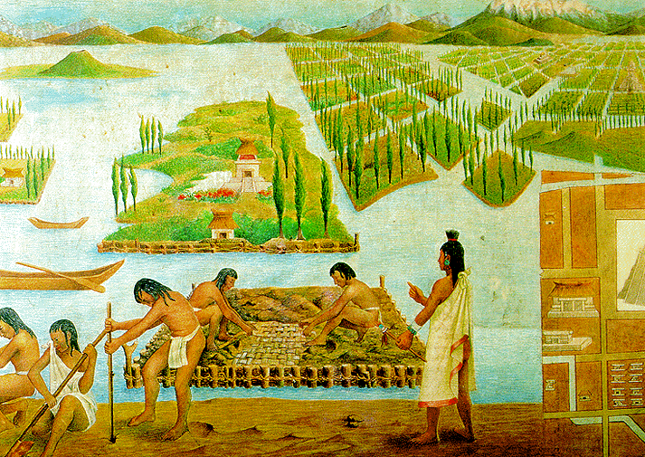
The Aztecs
Achievements
2 main calendars
Planned city of Tenochtitlan
Causeways or bridges to city
Chinampas: floating gardens
Notes:
Tenochtitlán: A Planned City By the early 1500s, Tenochtitlán had become an extraordinary urban center. With a population of between 200,000 and 400,000 people, it was larger than London or any other European capital of the time. Tenochtitlán remained on its original island site. To connect the island to the mainland, Aztec engineers built three raised roads, called causeways, over the water and marshland. Other smaller cities ringed the lake, creating a dense concentration of people in the Valley of Mexico.
Streets and broad avenues connected the city center with outlying residential districts. The canals that intersected with these roadways allowed canoes to bring people directly into the city center. Canoes also brought goods from the farthest reaches of the empire to the economic heart of the city, the huge market of Tlatelolco (TLAH•tehl•AWL•koh).
Visitors to the market also found a great deal of local agricultural produce on display, including avocados, beans, chili peppers, corn, squash, and tomatoes. Most of the fruits and vegetables sold at the market were grown on chinampas, farm plots built on the marshy fringes of the lake. These plots, sometimes called “floating gardens,” were extremely productive, providing the food needed for a huge urban population. At the center of the city was a massive, walled complex, filled with palaces, temples, and government buildings. The main structure in the complex was the Great Temple. This giant pyramid with twin temples at the top, one dedicated to the sun god and the other to the rain god, served as the center of Aztec religious life.

Slide 15
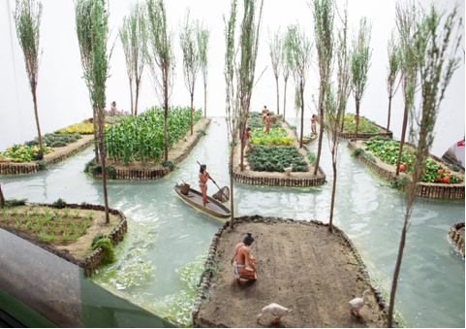
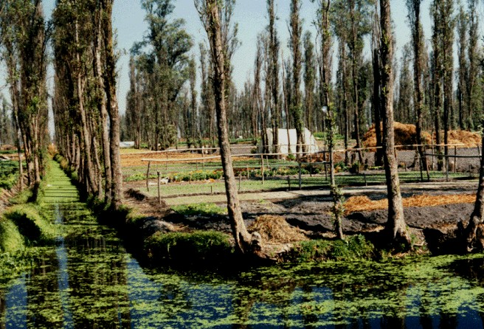
chinampas

Slide 16
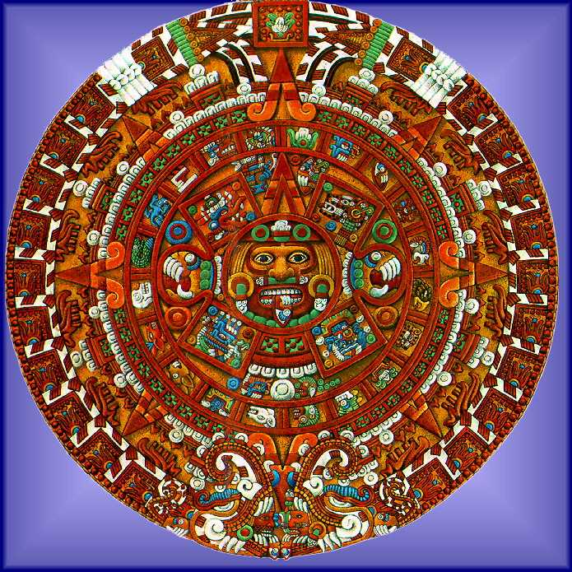
Complete the skillbuilder on pg 457 on the sheet connected to your notechart
Why do you think the Aztecs put Tonatiuh, a sun god, in the center of the Sunstone? Explain your reasons.
How is the Aztec calendar different from the calendar we use today? How is it similar?

Slide 17
Decline of the Aztecs
Empire weakened under Montezuma II
Asked for even more tribute and sacrifice
People rebelled
Montezuma tried to fix problems, but it was too late
Eventually conquered by Spanish
Notes:
In 1502, a new ruler, Montezuma II (MAHN•tih•ZOO•muh), was crowned emperor. Under Montezuma, the Aztec Empire began to weaken. For nearly a century, the Aztecs had been demanding tribute and sacrificial victims from the provinces under their control. Now, with the population of Tenochtitlán growing ever greater, Montezuma called for even more tribute and sacrifice. A number of provinces rose up against Aztec oppression. This began a period of unrest and rebellion, which the military struggled to put down.
Over time, Montezuma tried to lessen the pressure on the provinces. For example, he reduced the demand for tribute payment by cutting the number of officials in the Aztec government. But resentment continued to grow. Many Aztecs began to predict that terrible things were about to happen. They saw bad omens in every unusual occurrence—lightning striking a temple in Tenochtitlán, or a partial eclipse of the sun, for example. The most worrying event, however, was the arrival of the Spanish. For many Aztecs, these fair-skinned, bearded strangers from across the sea brought to mind the legend of the return of Quetzalcoatl.

Slide 18
Constructive Response Question
Who were the Aztecs and what did they do?
Answer this question in your own words on the sheet connected to your note chart

