Slide 1
Islam
pictures to go with discussion/notes

Slide 2
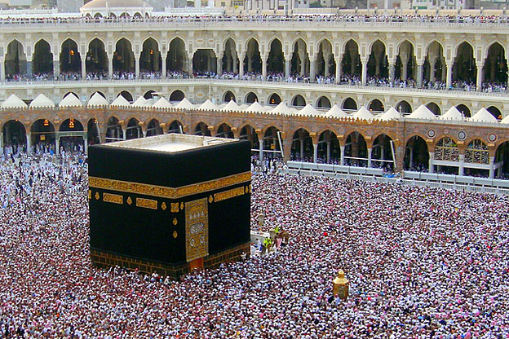
Ka’aba

Slide 3
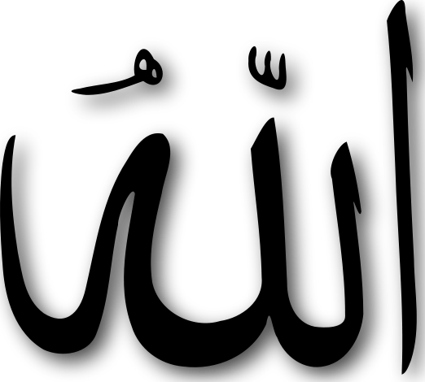
Faith

Slide 4
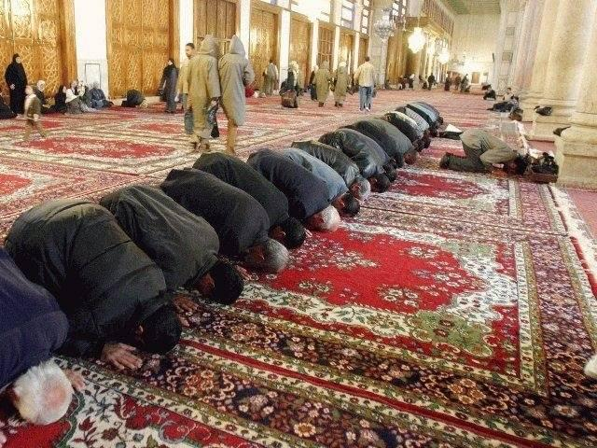
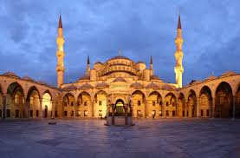
Prayer

Slide 5
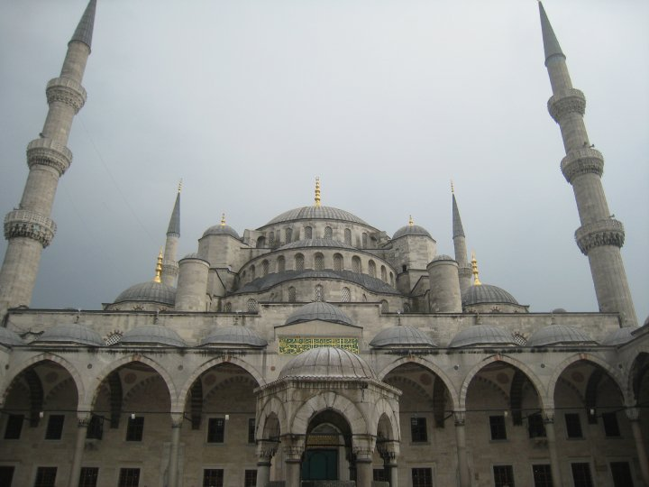
Blue Mosque

Slide 6
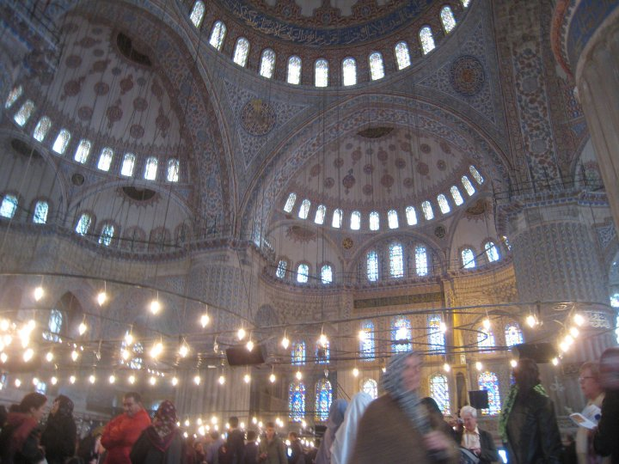

Slide 7
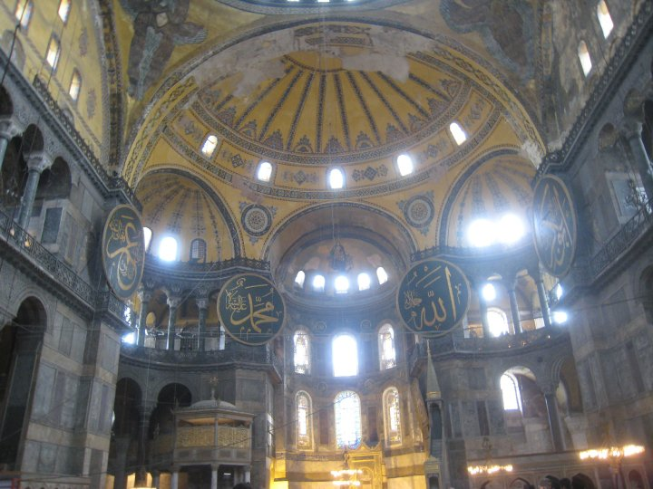
Hagia Sophia

Slide 8
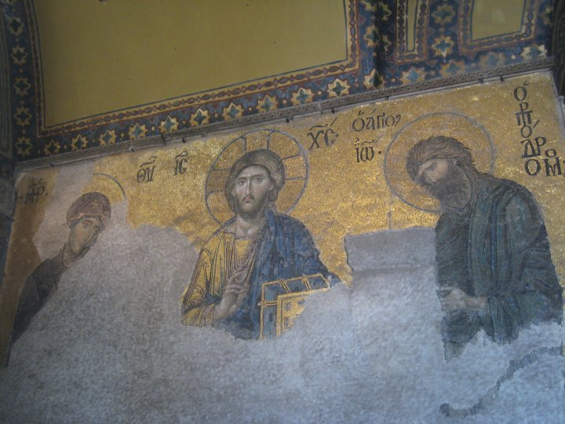

Slide 9
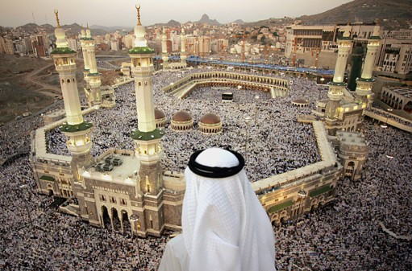
Pilgrimage (Hajj)

Slide 10
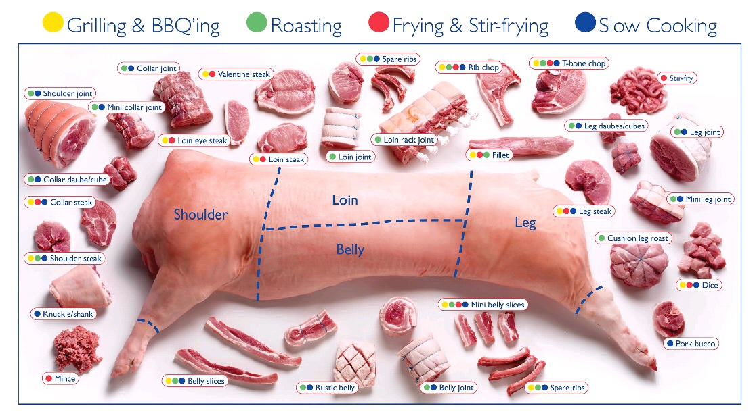
A way of life

Slide 11
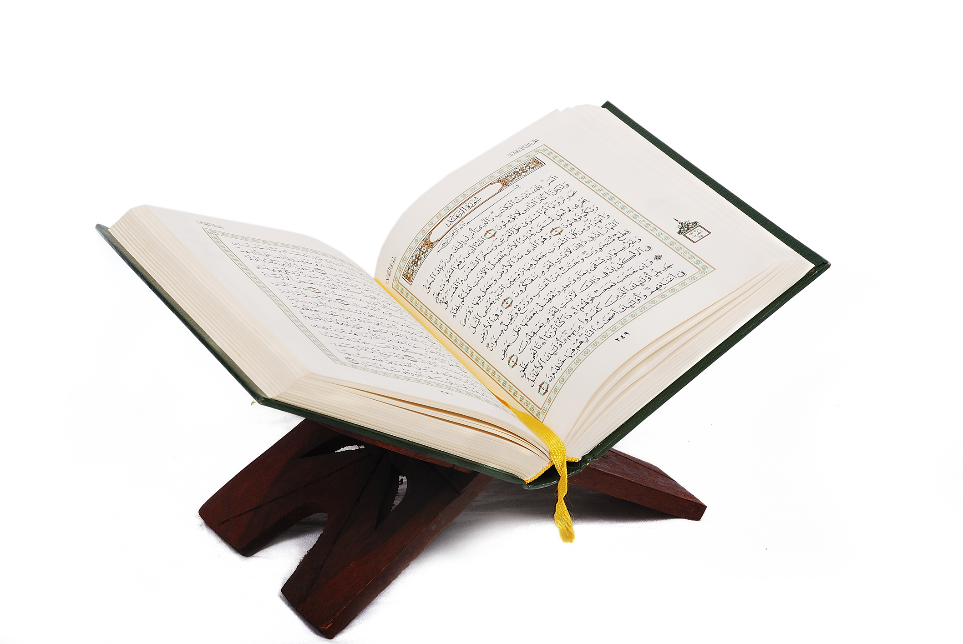
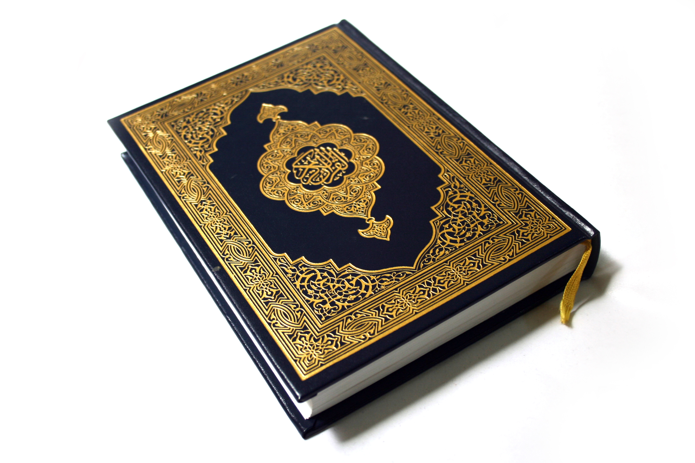
Qur’an

Slide 12
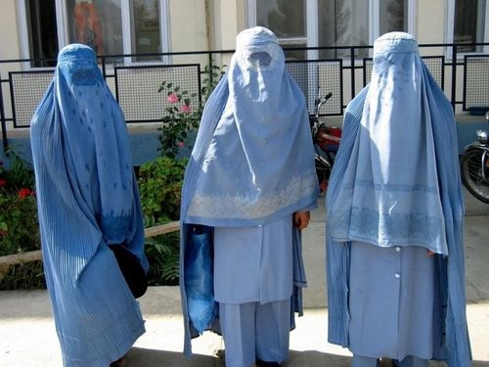
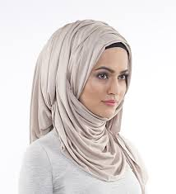
Hijab vs. Burqa
24:30-31 "And say to the believing women that they should lower their gaze and guard their modesty; that they should not display their beauty and ornaments . . . that they should draw their KHIMAR over their bosoms and not display their beauty except to their husbands. . . . ''

Slide 13
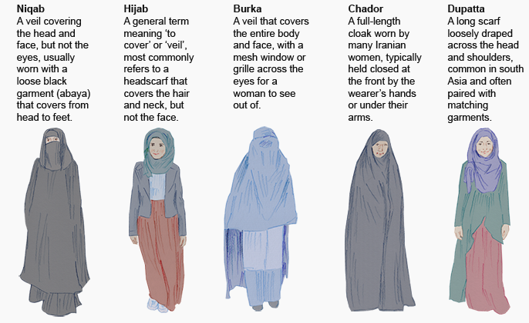

Slide 14
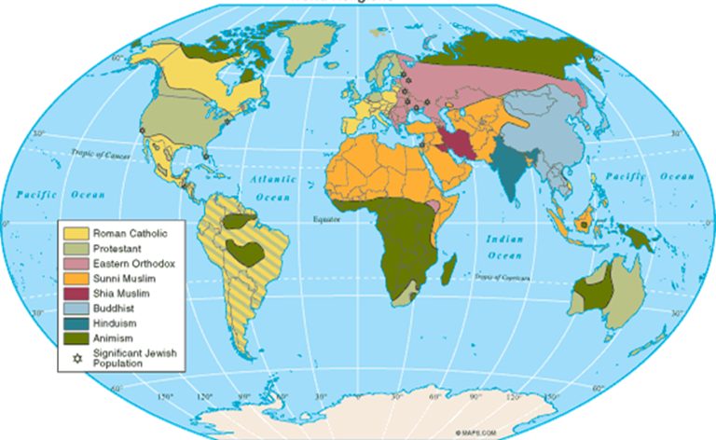
Muslims in the World Today

Slide 15
Countries with the largest Muslim population
Most Muslims are concentrated in the
Middle East and North Africa
Arabs make up only 20% of the total Muslim population of the world.

Slide 16
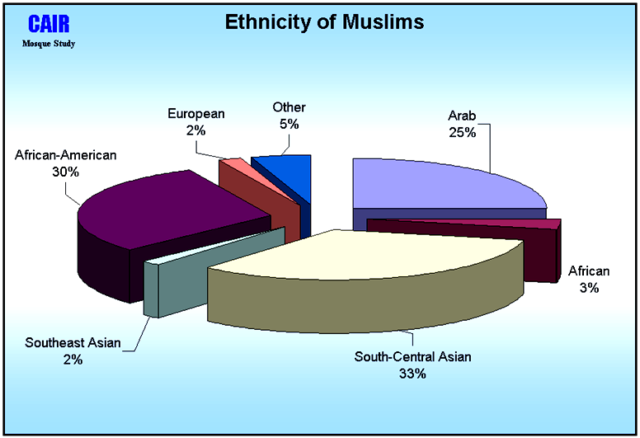
Ethnicity of Muslims

Slide 17
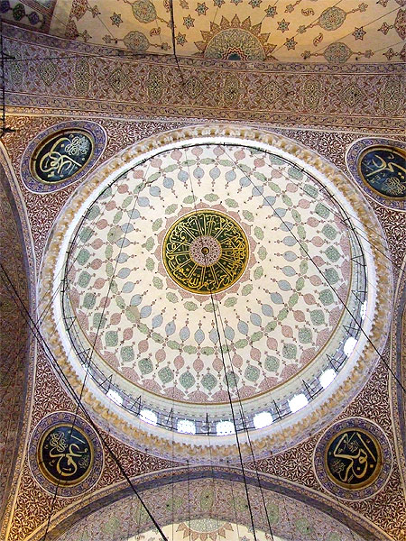
Rightly Guided Caliphs
Abu Bakr (632–634 CE).
Umar ibn al-Khattab(Umar І, 634–644 CE)
Uthman ibn Affan (644–656 CE)
Ali ibn Abi Talib (656–661 CE)

Slide 18
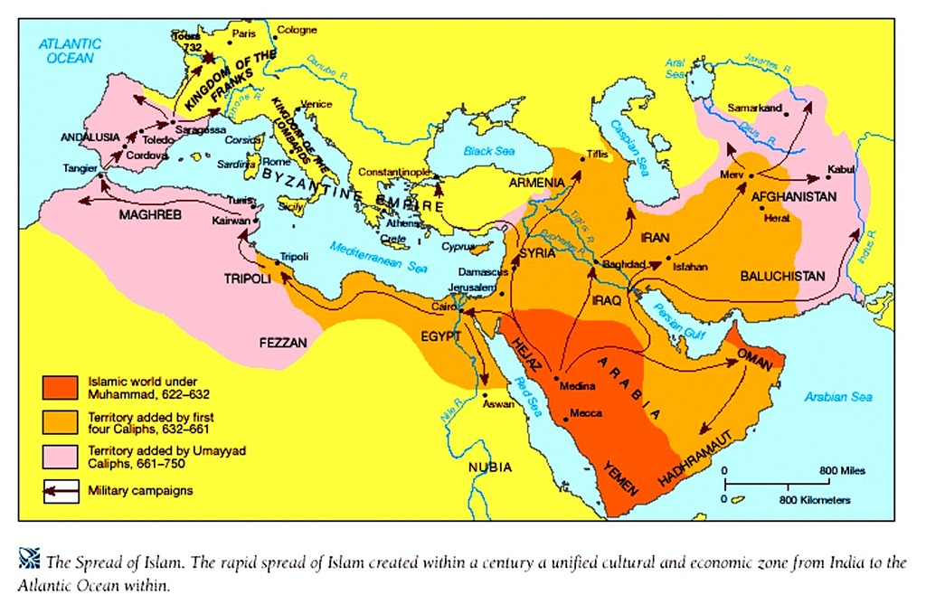
Muslim Conquests

