Slide 1
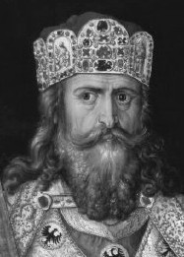
Germanic Kingdoms

Slide 2
CONSTRUCTIVE RESPONSE QUESTION
Who was Charlemagne and why is he significant?

Slide 3
GERMANIC KINGDOMS EMERGE

Slide 4
GERMANIC KINGDOMS EMERGE
Germanic Kingdoms
In the upheaval between 400 and 600, small Germanic kingdoms replaced Roman provinces
Borders changed constantly
Family ties and personal loyalty were more important than public government and written law
Germanic stress on personal ties made it impossible to establish orderly government

Slide 5
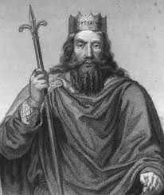
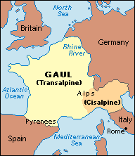
GERMANIC KINGDOMS EMERGE
Clovis and the Franks
Clovis was leader of the Franks and had power in Gaul
Clovis brings Christianity to the region
Fears defeat by another Germanic tribe and appeals to Christian God: Franks win
Clovis and 3,000 of his warriors ask a bishop to baptize them
By 511, Clovis had united the Franks in one kingdom

Slide 6
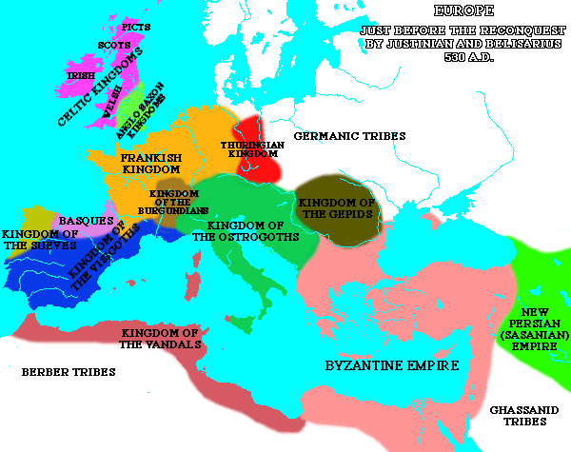
GERMANIC KINGDOMS EMERGE
A Frankish Empire Evolves
The Franks now controlled the largest and strongest of Europe’s kingdoms
When Clovis died in 511, the Franks controlled most of modern day France

Slide 7
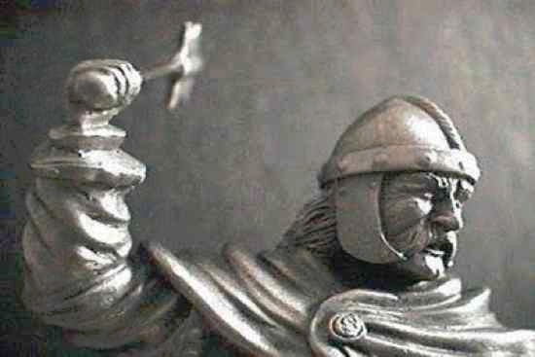
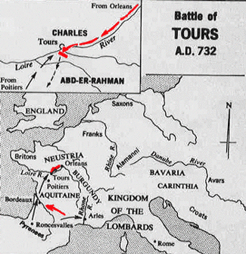
GERMANIC KINGDOMS EMERGE
Charles Martel or Charles the Hammer
Defeated Muslim raiders from Spain at the Battle of Tours in 732
Historians argue that if the Christians had lost, Muslims could have taken over Europe
Charles was a Christian hero; Christianity wins
At his death, he passed his power to Pepin the Short
Pope anoints Pepin “King by the grace of God,” thus beginning the Carolingian Dynasty- family that would rule the Franks from 751-987

Slide 8
Draw it out:
Draw an image to help you remember Charles
the hammer:

Slide 9
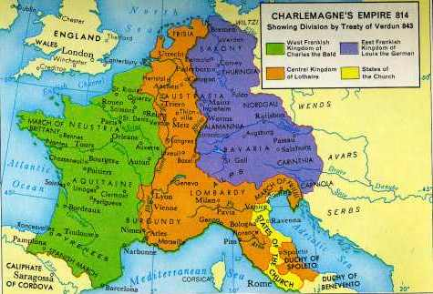
GERMANIC KINGDOMS EMERGE
Charlemagne
Pepin the short died in 768
Charles the Great, better known as Charlemagne takes over in 771
Imposing figure standing 6 foot 4 inches tall

Slide 10
GERMANIC KINGDOMS EMERGE
Charlemagne as King
Charlemagne built an empire greater than any known since the Romans
Was now the most powerful king in Western Europe
His conquests against the Muslims to the south and east spread Christianity
He united Western Europe for the first time since the Roman Empire
The empire became known as the Holy Roman Empire
Charlemagne strengthened his power by weakening power of the nobles
Encouraged learning- surrounded himself with scholars and opened new monasteries

Slide 11
Drawing Conclusions:
What was Charlemagne’s greatest achievement?
Give reasons for your answer.

Slide 12
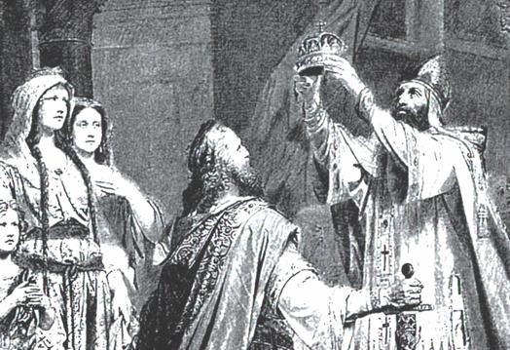
GERMANIC KINGDOMS EMERGE
In 800, he traveled to Rome to protect the pope → the pope rewards Charlemagne by crowning him emperor
This historic coronation showed that the pope had more power than the king

Slide 13
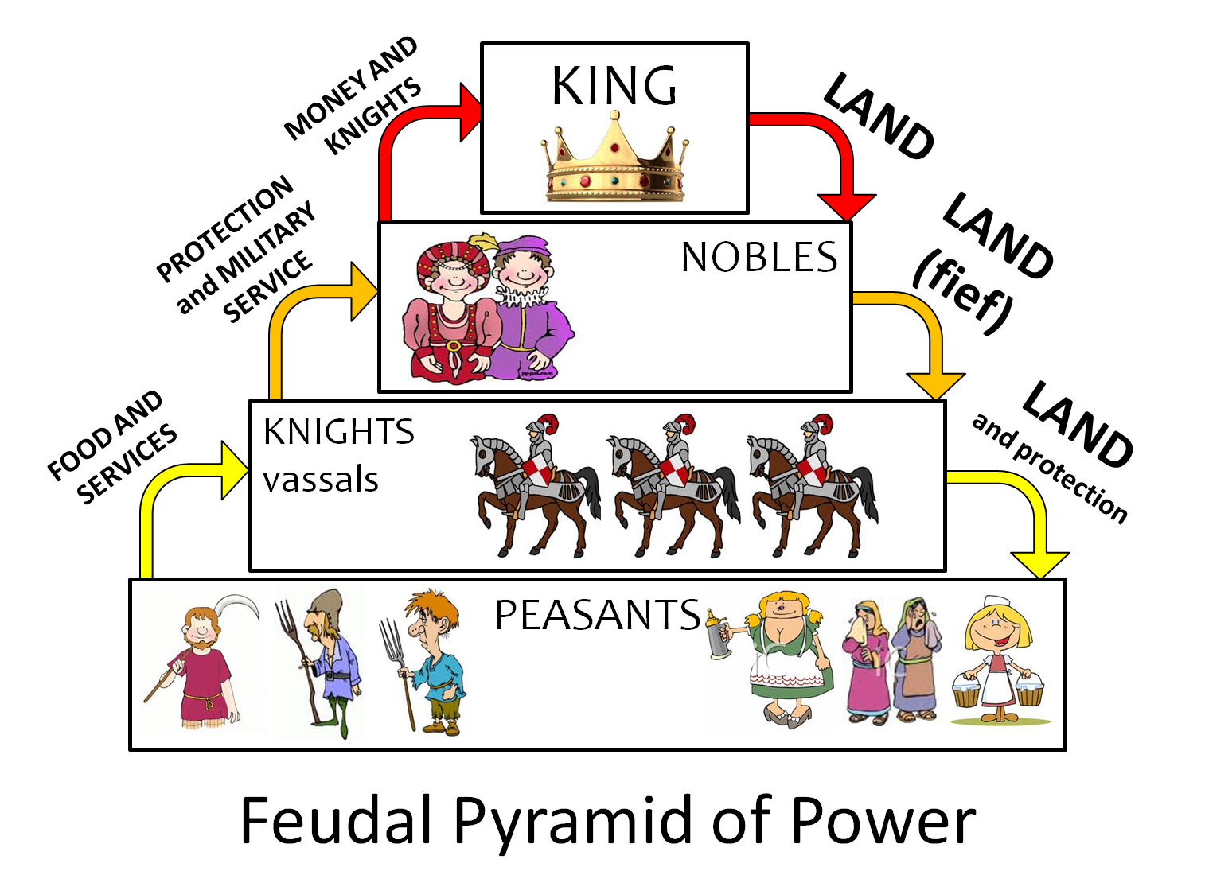
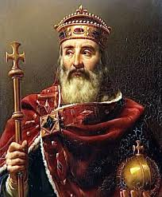
GERMANIC KINGDOMS EMERGE
Charlemagne died in 814, his grandsons split up the kingdom
Carolingian kings lost power and authority broke down
This led to the rise of feudalism

Slide 14
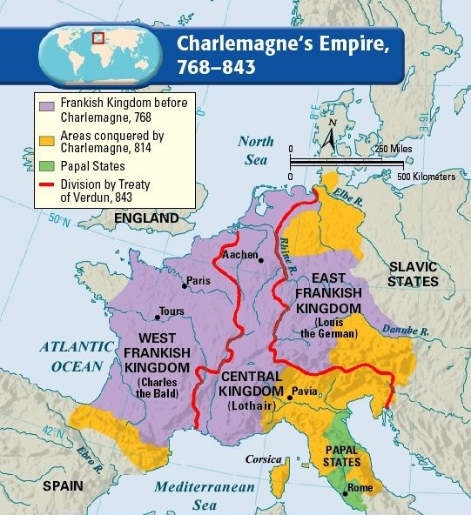
Interpreting Maps:
Complete the Geography Skillbuilder on page
356 in your textbook.
1.
2.

Slide 15
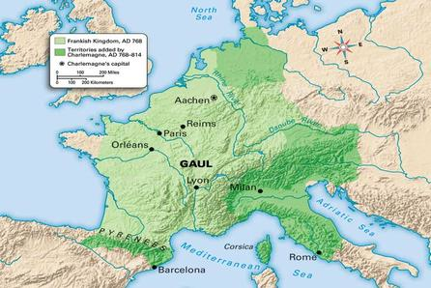
GERMANIC KINGDOMS EMERGE
Result: Through Christianity, Clovis was able to unite the Franks into a strong Christian, military power. Charles Martel solidified Christianity’s strength in Europe which helped lead to the eventual rise of the more powerful Frankish king Charlemagne.

Slide 16
CONSTRUCTIVE RESPONSE QUESTION
Who was Charlemagne and why is he significant?
Video: Charlemagne ("Call Me" by Blondie)
https://youtu.be/cTTaVnZyG2g

