Slide 1
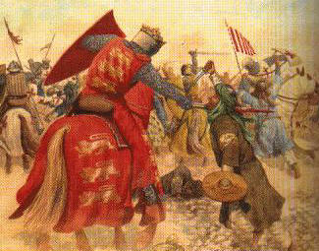
THE MIDDLE AGES
The Crusades

Slide 2
Constructive Response Question
What were The Crusades and what effect did they have on the people of Europe and the Holy Lands?

Slide 3
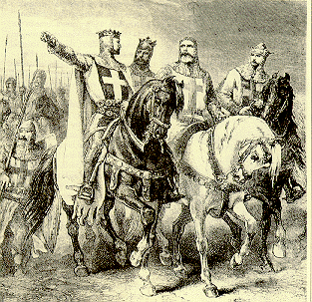
The Crusades
What is a crusade?
A holy war involving the journey of thousands of Europeans to reclaim the holy land of Jerusalem in the name of Christianity
In all, there were 8 or 9 Crusades (depending on your source)

Slide 4
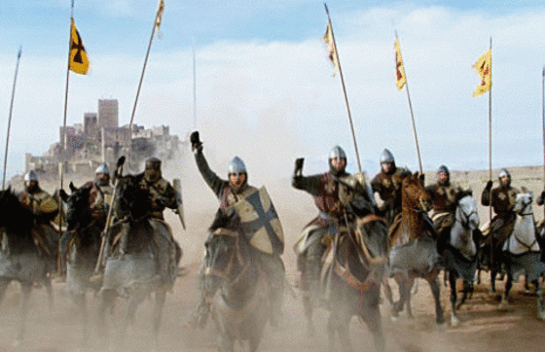
The Crusades
When were the Crusades?
Starts in 1093 and lasts for nearly 300 years

Slide 5
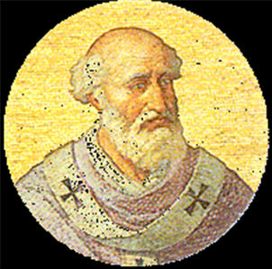
Pope Urban II

Slide 6
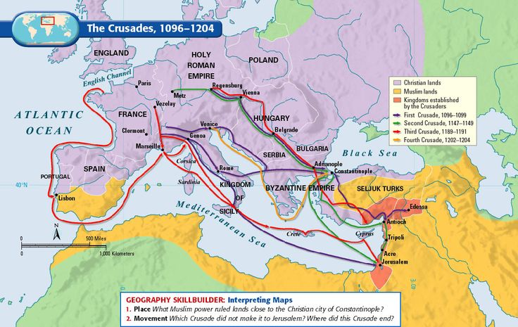
Complete the Geography Skillbuilder pg. 383

Slide 7
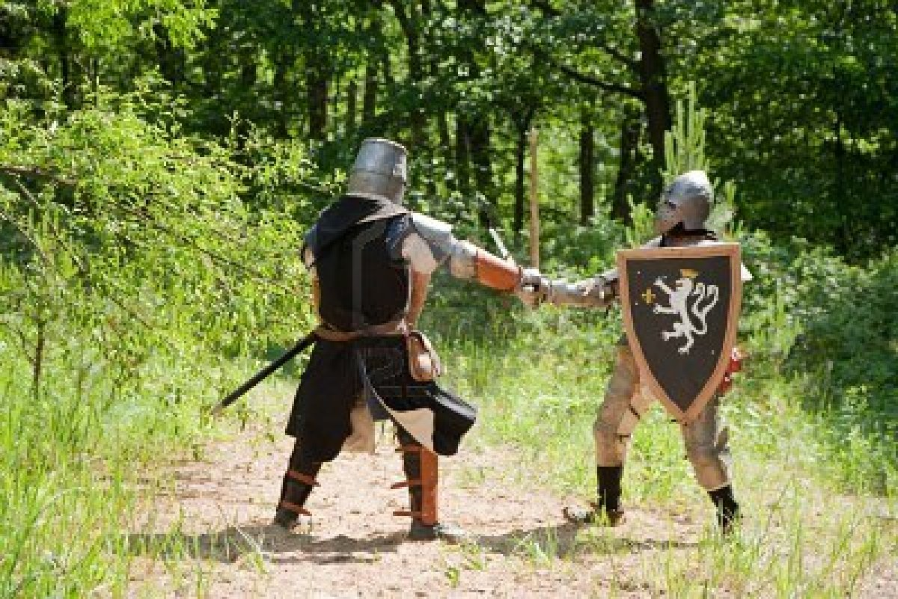
The Crusades
Why crusade? Social, Economic, Spiritual, & Political reasons
Social: Opportunity to get knights to stop fighting each other and fight a new foe. These knights threatened peace in Europe.
Economic: The Holy Lands of Jerusalem were generally wealthier than Europe and many wanted to get their share of that wealth

Slide 8
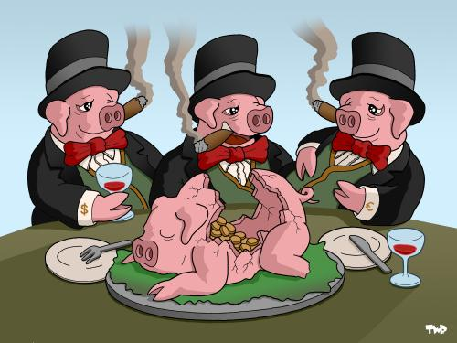
The Crusades
Why crusade? Social, Economic, Spiritual, & Political reasons
Economic: Younger sons who did not stand to inherit father’s property were looking for wealth and adventure
Economic: Merchants supplied loans to finance the journey

Slide 9
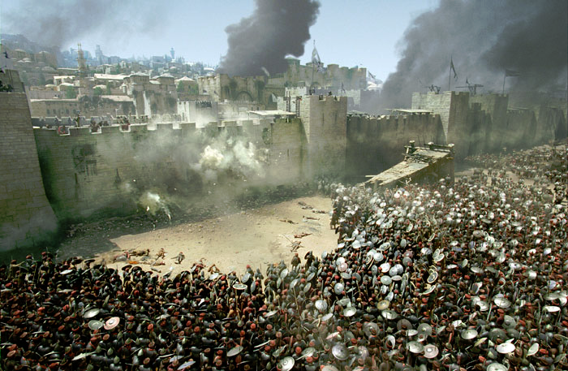
The Crusades
Why crusade? Social, Economic, Spiritual, & Political reasons
Political: A chance for the pope to gain territory instead of Byzantine rival
Spiritual: Fight/die on Crusade = ticket to heaven

Slide 10
Read the primary source on page 382 and answer the question. Annotate as you read.
What is the author’s purpose?

Slide 11
The Crusades
Effects of the Crusades
Example of Church power
Trade expanded between Europe and Southwest Asia
Thousands of knights and other participants lost their lives
Those who survived brought back culture to Europe
Persecution of Jews; thousands were slaughtered because they were seen as infidels
Failure of later crusades lessened the power of the pope
The Crusades weakened the power of the feudal nobility (Knights were dead)
Began a legacy of bitterness and hatred of Christians for the Muslims and vice versa

Slide 12
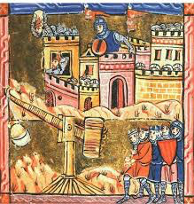
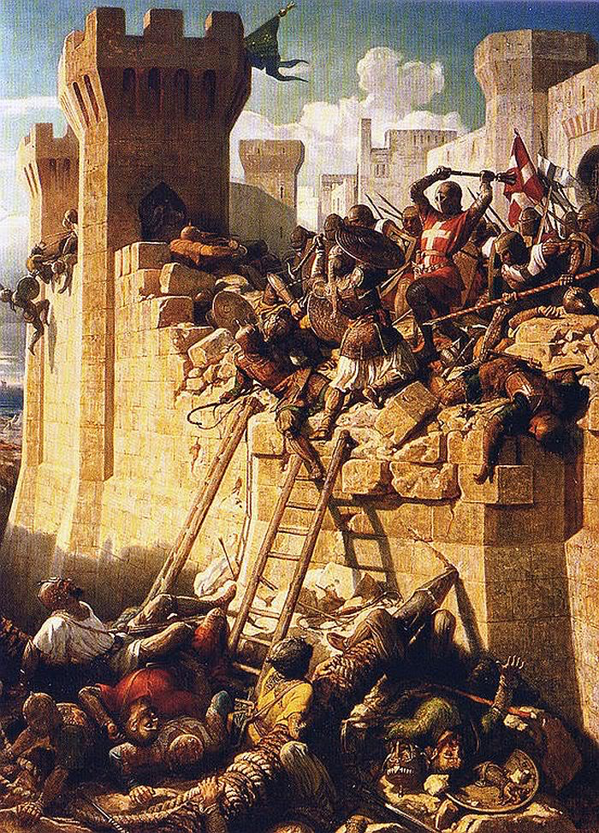
The Crusades
Result: The crusades were an example of an abuse of church power. The effects of the Crusades are still felt through that region of the world today.

Slide 13
Answer the constructive response question in your notes
What were The Crusades and what effect did they have on the people of Europe and the Holy Lands?
http://www.history.com/topics/crusades/videos/the-crusades
Crusades History Channel Video

