Slide 1
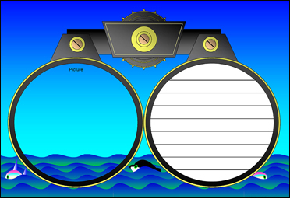
Annotating Text to Deepen Understanding
World Studies

Slide 2
Annotation is a note of any form made while reading text.
“Reading with a pencil.”

Slide 3
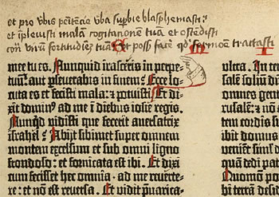
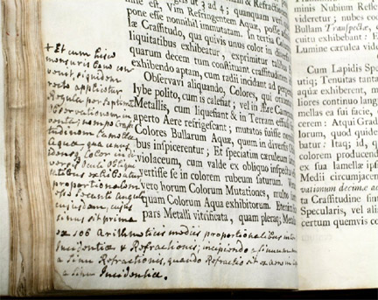
People have been annotating texts since there have been texts to annotate.

Slide 4
Annotation is not highlighting.

Slide 5
Annotation slows down your reading in order to deepen your understanding.

Slide 6
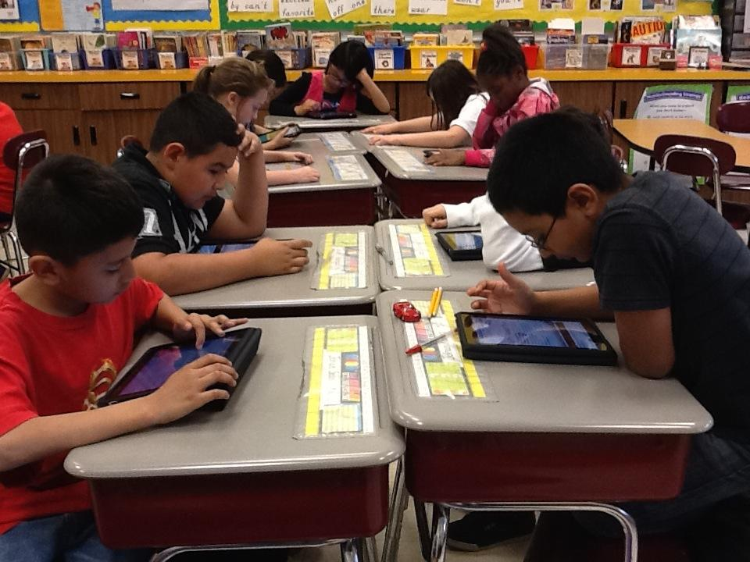
Annotation occurs with digital and print texts.

Slide 7
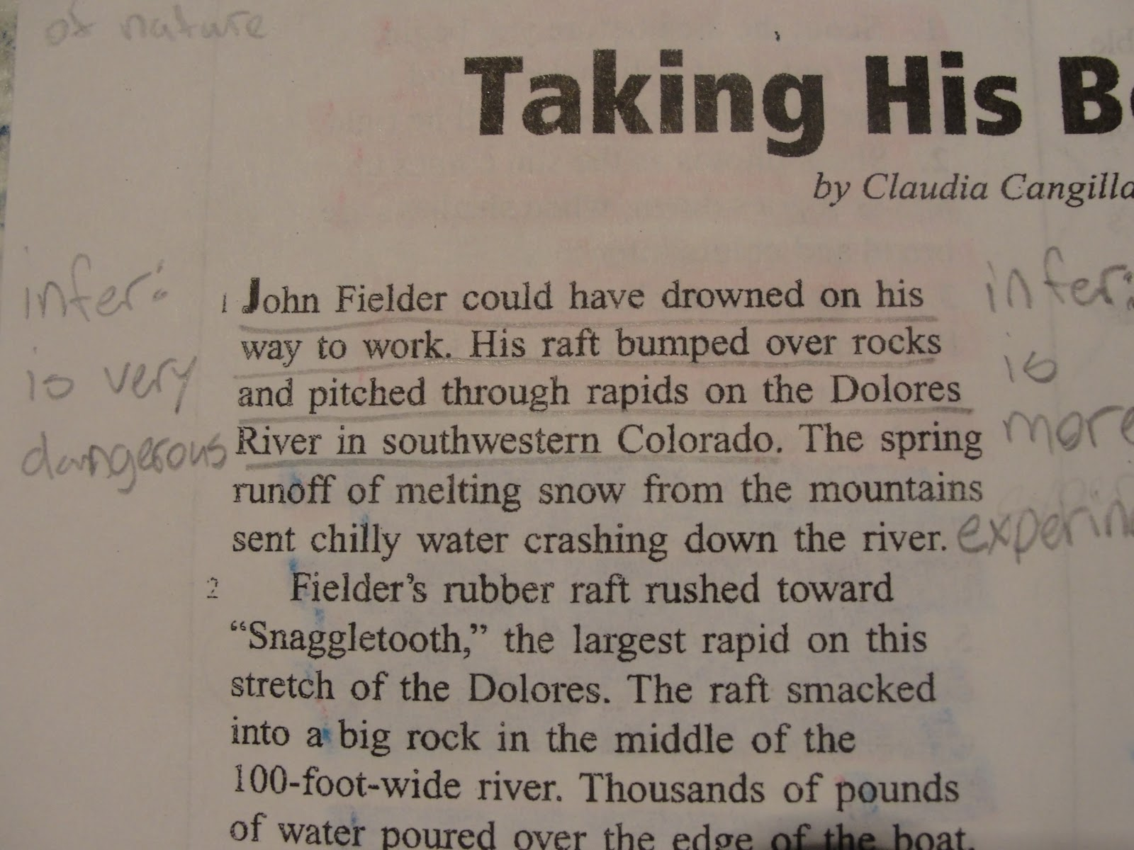

Slide 8
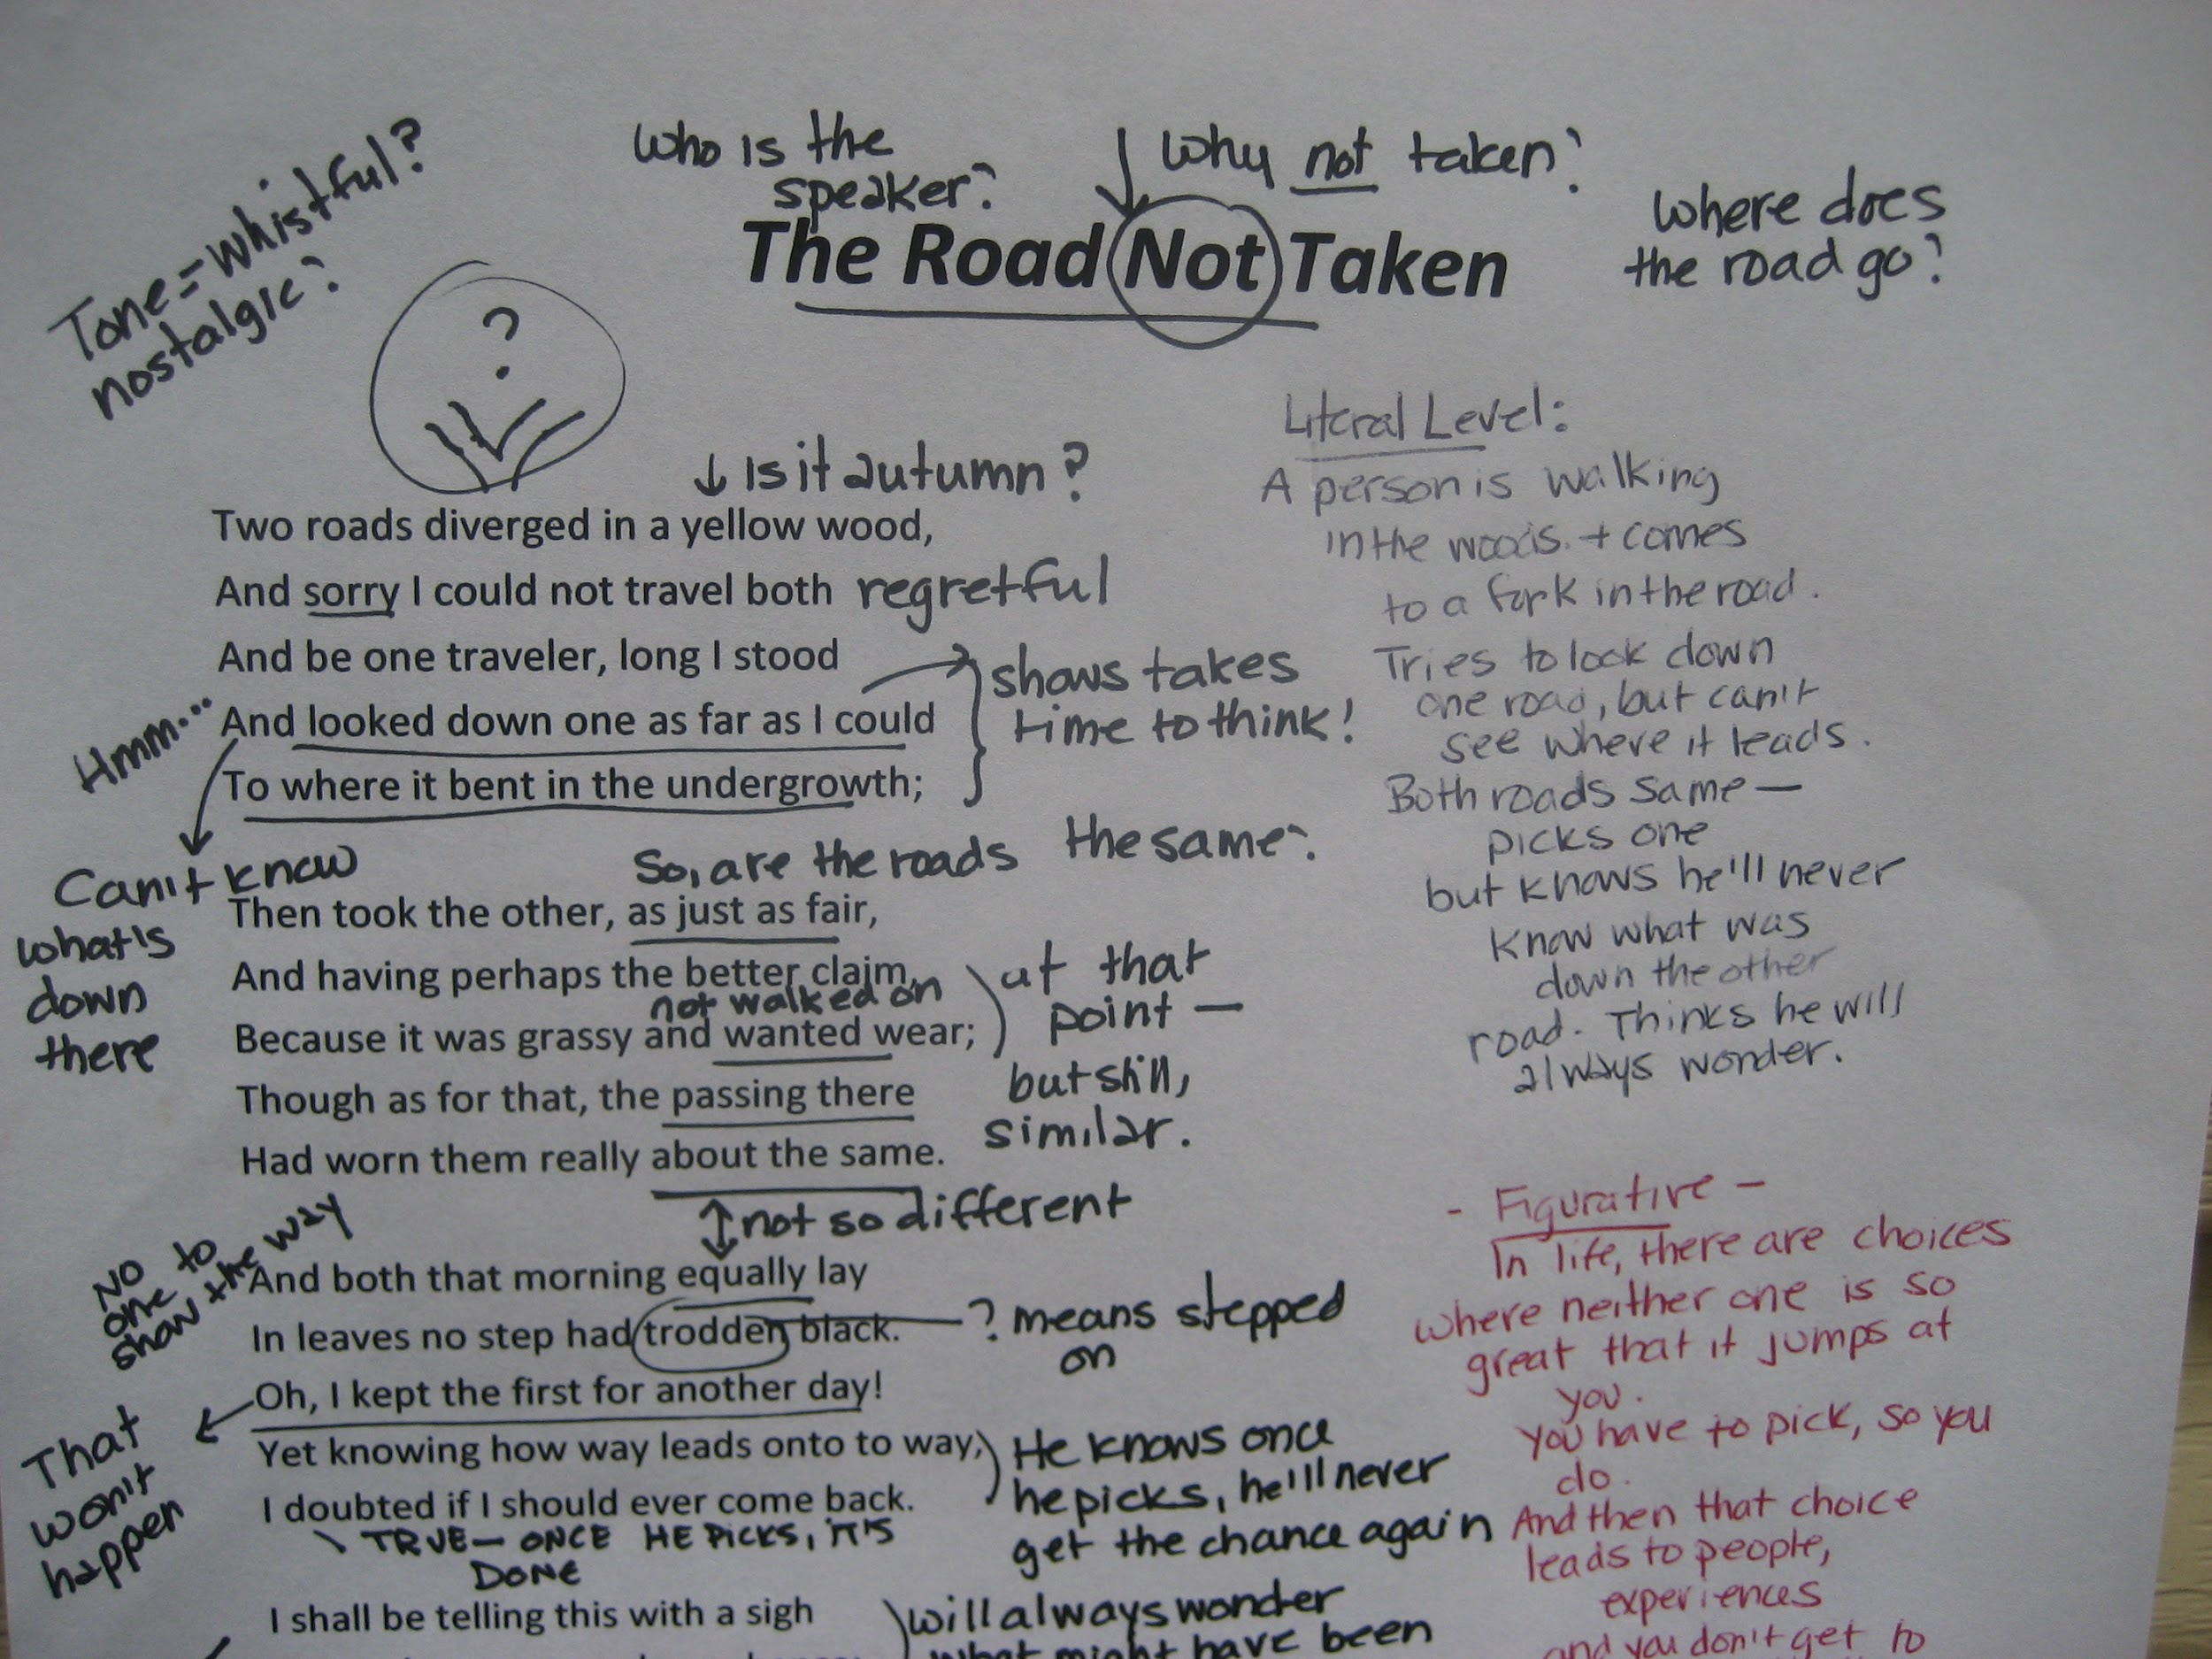
Modeling in 9th Grade English

Slide 9
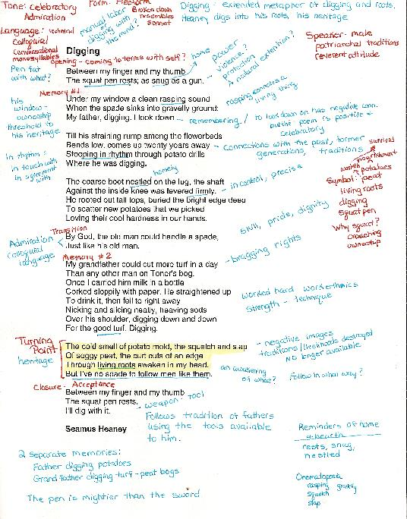
Student annotation in 11th grade English

