Slide 1
AFRICAN MASKS PROJECT
WORLD STUDIES SY16-17

Slide 2
Why?
Standard (writing): I can produce clear and coherent writing in which I answer a prompt in grade-level and academic language
Social Studies Content: local culture and material culture (items produced by people)
Cross-curricular: ART

Slide 3
What will I do?
Objective: 1. Read a simple text to determine main idea and supporting details of a text
2. Write a coherent paragraph that explains the mask you create 3. Create a mask that represents a historical person/celebrity

Slide 4
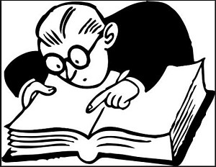
Part 1: Reading Comprehension
Read the following text and answer the questions that follow
You will be reading information about African Masks.
Look for main ideas and supporting details
Unfamiliar vocab has been defined for you if needed, examples have been provided to illustrate vocab words

Slide 5
Part 2: Creation and Writing
Written Requirement: Write 1 paragraph (8 sentences) about whom the mask celebrates and what it represents. Answer the prompt below.
-Fully answer the prompt -Explain 3 symbols, marks, color, shaped used on your mask -Include a topic sentence, conclusion, and 3 supporting details -Use transition words -Use grade-level vocabulary -Double-check your grammar!
Mask Requirements: Create a design for your own mask. It must include
-3 patterns or symbols -use of color -no visible pencil marks (outlined in marker/colored pencil/crayon)
Prompt: How does your decorative mask represent a historical figure/celebrity?

Slide 6
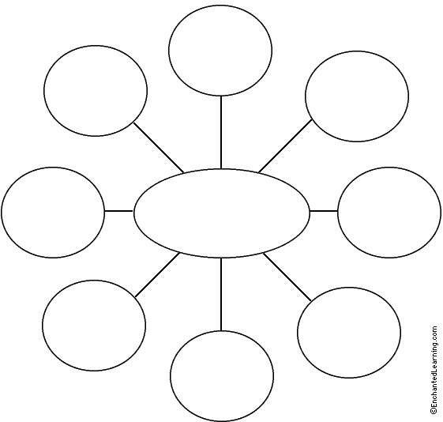
Web Brainstorm
-Draw a web graphic organizer in the space provided with 10 outside circles.
-Include the person’s name in the middle circle.
-Include at least 3 adjectives, 3 colors, 3 hobbies, and 1 animal that help to describe the person you are creating the mask about
-For more detailed brainstorming, create additional circles off of the main ones to provide explanations

Slide 7
Cat
Blood
Heroin
Red
White
Attention Seeking
Kurt Cobain
Black
Creative
Depression
Art
Misunderstood
Filmmaking
Music
Macabre
Grunge
Pain
Drug Addict

Slide 8
Kurt Cobain

Slide 9
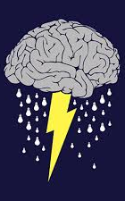
Making your mask….
We provide a space for you to create a rough draft of your mask: Use the ideas from your web brainstorm and incorporate them in your mask!

Slide 10
Symbols and Patterns for your Mask
you don’t need all of them and you aren’t limited to these: -color -geometric shapes -interlacing crosses -animal characteristics (man/nature relationship) -patterns: parallel lines, zigzags, curved and spirals lines -human characteristics (braided hair?) -Islamic influence (think back to when we studied Muslim art and culture…)

Slide 11
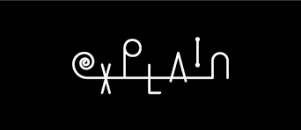
Other things to consider…
Bold pattern-painted or carved
geometrical and symmetrical
checkerboard grids
Hairstyles
Remember…you have to explain WHY you chose your symbols!

Slide 12
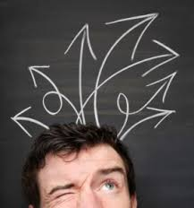
Writing about your mask….
Prompt: How does your decorative mask represent a historical figure/celebrity?
Answer the prompt!
Pay attention to the example used in class
Don’t forget to cite 2 sources in MLA below your paragraph

Slide 13
This decorative mask represents Kurt Cobain, a talented musician,through various shapes, patterns and colors. As lead singer of the 90s grunge band Nirvana, Kurt wrote most of the lyrics to their music and played lead guitar. Black lines have been symmetrically added to each side of the mask’s face to represent the guitar. In addition to the black lines, the Buddhist wheel of dharma is included as the eyes on the mask because Kurt was known to be interested in Buddhist teachings. In fact, he used the Buddhist concept of Nirvana for his band name. In the end, Kurt chose to commit suicide at the age of 27; As a result, red and white zig zags are utilized near the temples of the mask to represent his death by gunshot wound and heroin as well as the depression he suffered from. In brief, the inspirational lead singer of Nirvana, Kurt Cobain, can be seen in this mask through the many shapes, patterns and colors that reflect his short life.

Slide 14
Transitions
Transition Words and Phrases
Adding information
also, and, as well, besides, equally important, finally, furthermore, in addition, moreover, then, too
Comparing ideas
in like manner, in the same way, likewise, similarly
Conceding a point
agreed, certainly, granted, obviously, of course, to be sure
Contrasting ideas
at the same time, but, conversely, even so, even though, however, in contrast, nevertheless, nonetheless, on the one hand, on the other hand, still, yet
Providing an example
as an illustration, as can be seen by, for example, for instance, in other words, namely, specifically, to illustrate
Relating time and order of ideas
afterward, before, currently, eventually, finally, first, (second, third, fourth, fifth?), immediately, in the future, in the past, later, less important, meanwhile, most important, next, often, sometimes, soon, subsequently, then, today, when
Resulting from the previous idea
accordingly, as a result, consequently, so, thereby, therefore, thus
Showing relative location
adjacent, at the side, between, here, in the back, in the background, in the distance, in the foreground, in the front, nearby, there, to the side
Summarizing ideas
finally, hence, in brief, in conclusion, in short, in summary, that is, that is to say, to sum up

Slide 15
Let’s check the rubric and discuss due date….to the rubric!
Due: Monday, December 19th

Slide 16
Let’s look at examples more closely

Slide 17
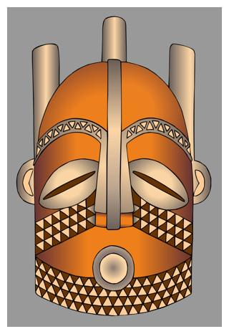
AFRICAN MASKS - BIOMBO
carved from wood and colored with red "tukula" powder, a dye made from a tree.
eyes are a typical coffee bean shape.
triangular checkerboard design is used to decorate the eyebrows and the planes of the face.
three forms at the back of the head represent the Biombo hairstyle.
Feathers are often attached to the top of Biombo masks.
Biombo masks are usually worn during tribal rituals and ceremonies

Slide 18
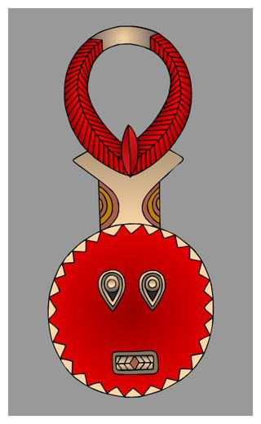
AFRICAN MASKS – Baule
Used during harvest festivals and to honor important
visitors, at funerals for important people
Circle face = life-giving force of the sun
Horns = buffalo
Material= wood, two holes for eyes for the wearer to see
Geometric shape = rectangular mouth
Symmetrical

Slide 19
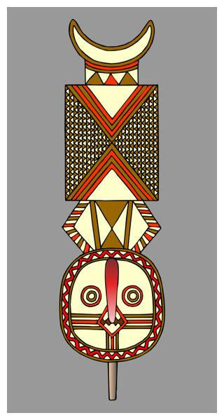
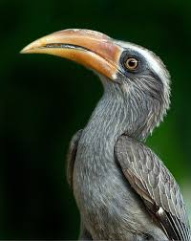
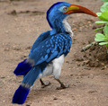
AFRICAN MASKS – Bwa
Those who wear this thought to have special powers (based on birds who are thought to possess magical powers)
Shapes = circle at one end and crescent moon at the other
Wearer would look through the mouth hole
Eyes = owl
Nose = hornbill
Geometric patterns and symmetry
Used to celebrate boys’ initiation into adulthood

Slide 20
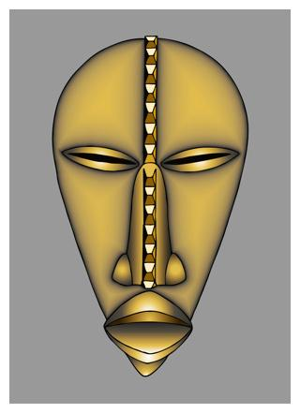
AFRICAN MASKS – Dan
High forehead, pouting mouth, pointy chin
Scarification marks (this one splits the forehead and nose)
Carved into wood and stained with brown dye
Sacred objects-used for protection and channel of communication with the spirit world
When dancers wear these masks, they become the spirit

Slide 21
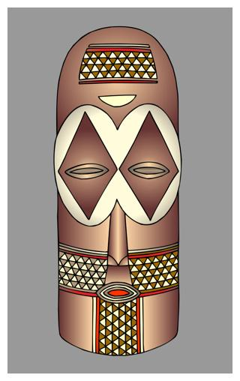
AFRICAN MASKS – Goma
Used in Central Africa
Geometric shapes on the planes of the face
Symmetry
Triangular pattern

Slide 22
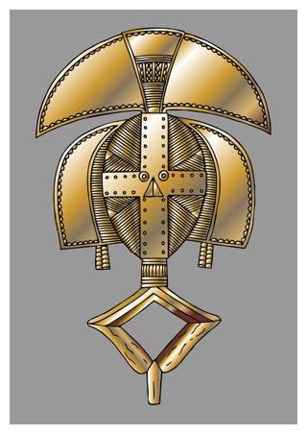
AFRICAN MASKS – Kota
Carved in wood and covered in brass or copper
Stylized heads with oval faces
Convex surface for boys
Concave surface for girls
Some have faces on both sides of the head
Use to communicate with ancestor to get assistance with their troubles in life

Slide 23
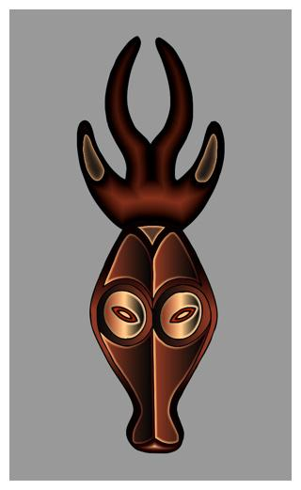
AFRICAN MASKS – Ligbi
Mask used to celebrate Islamic holidays, especially at the end of Ramadan
Dancers who wear them are noted for elegant, synchronized movements (in sync!)
Long face with wings on both sides (symmetry)
Eyes are shaded
Rectangular mouth
Human and animal forms combined
Makeup and jewelry are used to decorate the masks during celebration

Slide 24
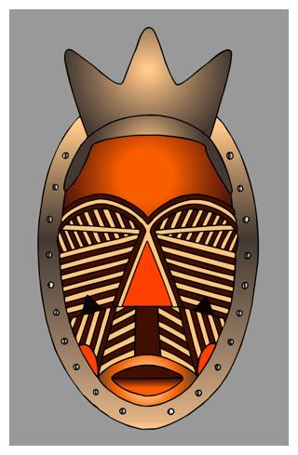
AFRICAN MASKS – Lulua
Lulua were famous for decorating their bodies with intricate scarification and tattoos
Represented both of these in their masks
Carved with geometric patterns and colored with reddish dye and pigment
Pointed form on the top of the head = Lulua hairstyle

Slide 25
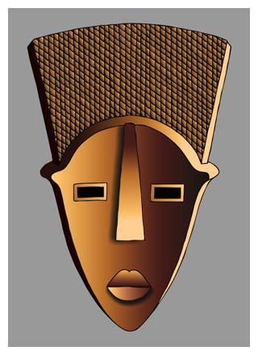
AFRICAN MASKS – Lwalwa
“mvondo” mask = worn by men
Simple geometric forms for features of the face
Eyes-rectangles nose-long, flat triangle ears-small bumps
Chin-pointed
Wood and dyed with fruit from mukula tree
Worn during celebrations, especially during initiation of young men into adulthood

Slide 26
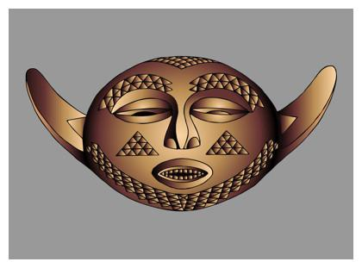
AFRICAN MASKS – Pende
Combines human and animal (buffalo) features
Carved triangular grids painted light and dark to make a checkerboard effect

Slide 27
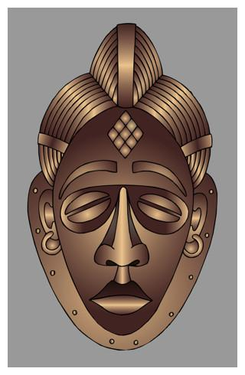
AFRICAN MASKS – Punu
Ideal beauty of Punu women (but only carved by men)
High hairstyle
Diamond-shaped scarification marks on forehead
Hairstyle suggests wealth (not flattened by carrying goods on her head)
Sometimes painted white with kaolin clay to represent the spirits of dead ancestors during funerals
Adorned with jewelry

Slide 28
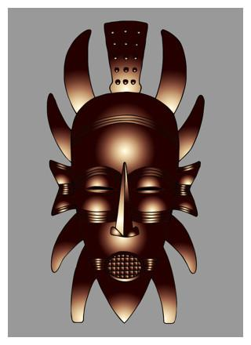
AFRICAN MASKS – Senufo
Human and animal features
Help the wearer in communication between the living and the dead ancestors
Used in celebration and rites in the Poro society, patriarchal society that educated young men in the responsibilities necessary for adulthood

Slide 29
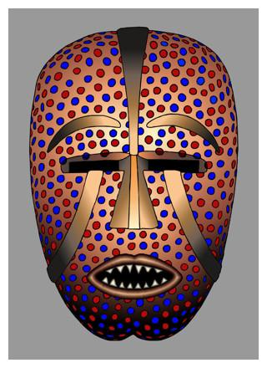
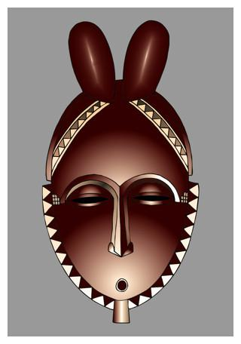
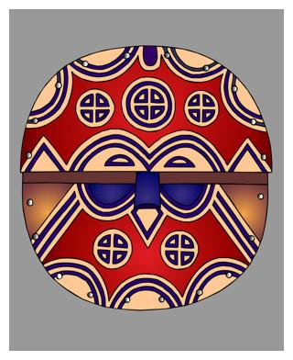
Other examples…

Slide 30
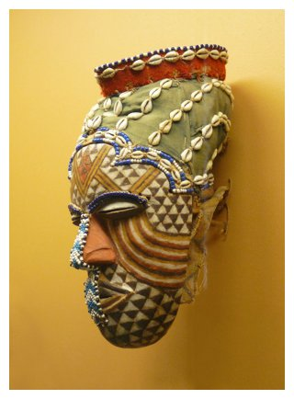
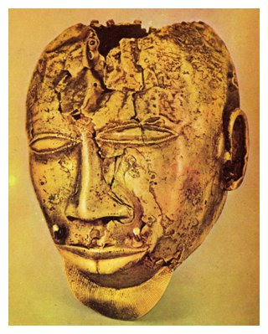
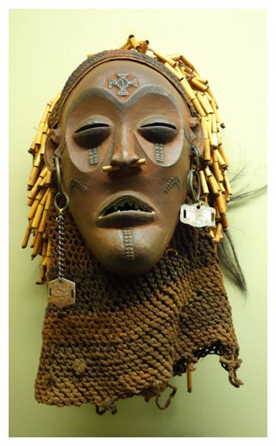
Other examples…

Slide 31
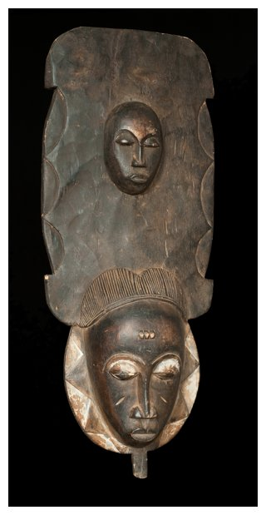
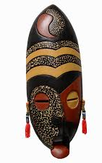
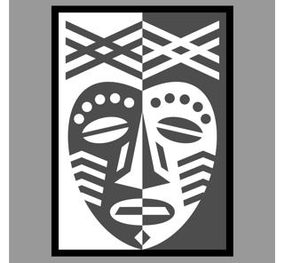
Other examples….

Slide 32
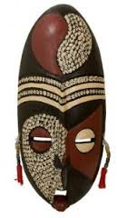
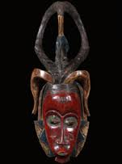
Other examples….

Slide 33
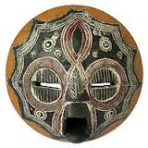
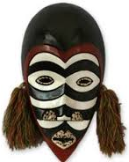
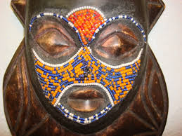
Other examples….

Slide 34
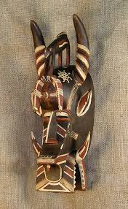
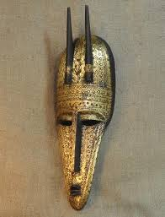
Other examples….

Slide 35
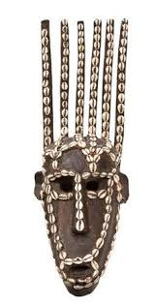
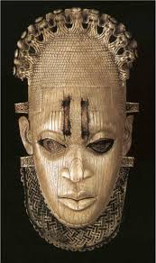
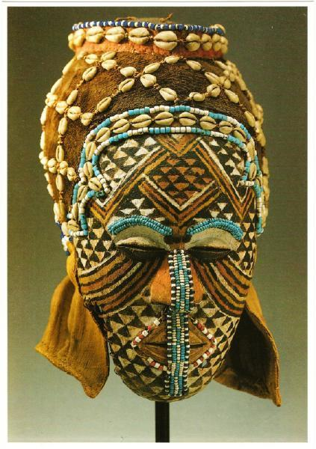
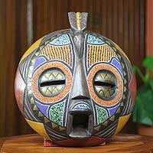
Other examples….

