Slide 1
Age of Exchange and Encounter (Part 2)
500-1500

Slide 2
European Middle Ages
Middle Ages- era of European history after the fall of the Roman Empire
New culture emerges with roots in:
Classical heritage of Rome
Beliefs of the Roman Catholic Church
Customs of various Germanic tribes

Slide 3
Medieval Society
Economic System: Manors
Lord’s estate
Set of rights and obligations between serfs and lords
Self-sufficient community producing a variety of goods
Code of Behavior: Chivalry
Displays of courage and valor in combat
Respect toward women
Devotion to feudal lord and heavenly lord
Belief System: The Church
Power over people’s everyday lives
Unifying force of Christian faith
Involvement in political affairs
Political System: Feudalism
Form of government based on landholding
Alliances between lords and vassals
Oaths of loyalty in exchange for land and military service
Ranking of power and authority

Slide 4
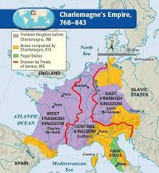
Charlemagne
Built an empire greater than any known since ancient Rome
Defeated Muslims in Spain
Spread Christianity
Crowned emperor by the Pope

Slide 5
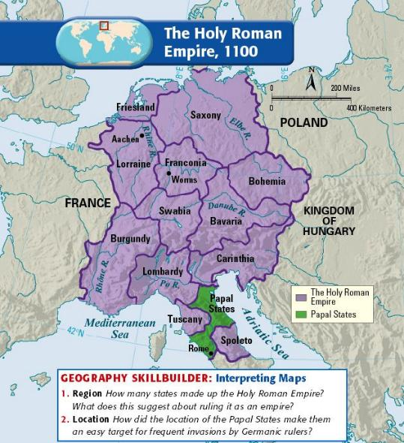
Holy Roman Empire
Founded by Otto the Great
Remained the strongest state in Europe until 1100

Slide 6
Europe in the Middle Ages
Economics:
Better farming methods increased food production
Trade expanded
Guilds formed for both merchants and artisans
Politics/Government:
England and France developed strong central governments
Parliament and the Estates-General bring representation to commoners
Parliament- Legislative group in England
Magna Carta- Guarantees basic political rights
Estates-General- Meeting of the three estates in France, helped increase royal power against nobility
The Hundred Years’ War further weakened feudal power

Slide 7
Europe in the Middle Ages
Religion:
Kings and popes engaged in power struggles
The Great Schism weakened the Church
Split in the Catholic Church- 2 Popes
The First Crusade captured Jerusalem
Later Crusades accomplished little
Society:
Population increases in the Middle Ages
The bubonic plague killed millions and weakened the manorial economy
Europe’s first universities developed

Slide 8
Societies and Empires in Africa
Society/Empire | Organization and Time Period | Important Facts
Ghana | West African empire from 700s- 1076 | Grew wealthy and powerful by controlling gold-salt trade
Mali | West African empire from 1235-1400s | Mansa Musa’s hajj (pilgrimage) made Mali’s wealth famous
Songhai | West African empire from 1400s- 1500s | Conquered Mali and gained control of trade routes

Slide 9
Major Trade Networks
Route | Trading Partners | Trade Goods | Method of Transportation
Trans-Arabia | Sassanid Empire Arabia Byzantine Empire | East Asia: silk, gems, dyes, cotton cloth Arabia: Incense, spices Southwest Asia: Wool, gold, silver | Camel Caravans
Silk Roads | China India Persia and Central Asia Europe | Asia: Silk, porcelain, spices, precious woods, gems Europe: Wool cloth, gold, silver | Caravans of camels and other pack animals

Slide 10
Major Trade Networks
Route | Trading Partners | Trade Goods | Method of Transportation
Mediterranean | Europe North Africa Southwest Asia | Europe: Wool and linen cloth, wine, metal North Africa: Wool Asia: spices, fruit, cloth | Sea: Galleys with numerous rowers Land: Caravans of pack animals
Trans-Sahara | North Africa West Africa | North Africa: Cloth, salt, horses, guns West Africa: Gold, dyed cloth, leather goods, slaves | Camel caravans

Slide 11
Major Trade Networks
Route | Trading Partners | Trade Goods | Method of Transportation
Indian Ocean | China India Arabia East Africa | Asia: Porcelain, silk, jewelry, cotton East Africa: Ivory, gold, tortoiseshell, leopard skins, slaves | Arab dhows Cinese junks

