Slide 1
Age of Exchange and Encounter (Part 1)
500-1500

Slide 2
The Muslim World
The spread of Islam and achievements of the Muslim world from 600-1250.

Slide 3
The Arabian Peninsula
Crossroads of 3 continents
Africa, Europe, Asia
Trade routes connected
Concept of one God was well known
570 AD- Muhammad born
Revelations -> Teachings
Islam- “submission to the will of Allah”
Muslim- “one who has submitted”

Slide 4
Islam
Muhammad receives revelations from Allah
The Five Pillars of Islam are Muslims' basic religious duties
The Qur’an and the Sunna guide Muslim’s daily life
Islam divides into several branches
Sunni
Shi’a

Slide 5
Muslim Culture
Muslim scholars preserve, blend, and expand knowledge
Especially in mathematics, astronomy, architecture, and medical science

Slide 6
Muslim Empires
Caliph- leader (translates to “successor” or “deputy”)
Caliphate- organization of states in Muslim empire

Slide 7
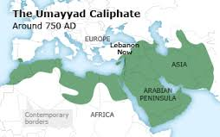
The Umayyad Caliphate (661-750)
Moved Muslim capital to Damascus and began to surround themselves with wealth and ceremony
Gives rise to a fundamental division in the Muslim community
Sunni-Shi’a Split
Rebel groups overthrow the Umayyads in 750

Slide 8
Sunni and Shi’a Muslims
Sunni | Shi’a
Believe the first four caliphs were “rightly guided” | Believe that Ali, the Prophet’s son-in-law, should have succeed Muhammad
Believe that Muslim rulers should follow the Sunna, or Muhammad’s example | Believe that all Muslim rulers should be descended from Muhammad; do not recognize the authority of the Sunna
Claim that the Shi’a have distorted the meaning of various passages in the Qur’an | Claim that the Shi’a have distorted the meaning of various passages in the Qur’an
Approximately 83% of Muslims worldwide today | Approximately 16% of Muslims worldwide today

Slide 9
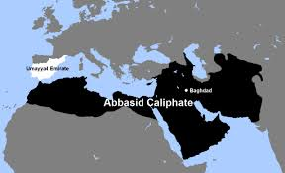
The Abbasid Caliphate 750-1258
Moved capital to Baghdad (Iraq)
Preside over the “Golden Age” of Muslim culture, where much of Muslim culture is established
Increased authority but failed to keep complete political control of the large territory

Slide 10
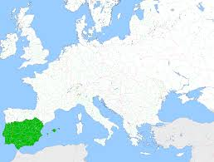
The Umayyads of al-Andalus (756-976)
Spain
Will hold the area of Spain until their defeat in 732 (Battle of Tours)
Their libraries will later bring the light of the Renaissance to Middle Ages Europe

Slide 11
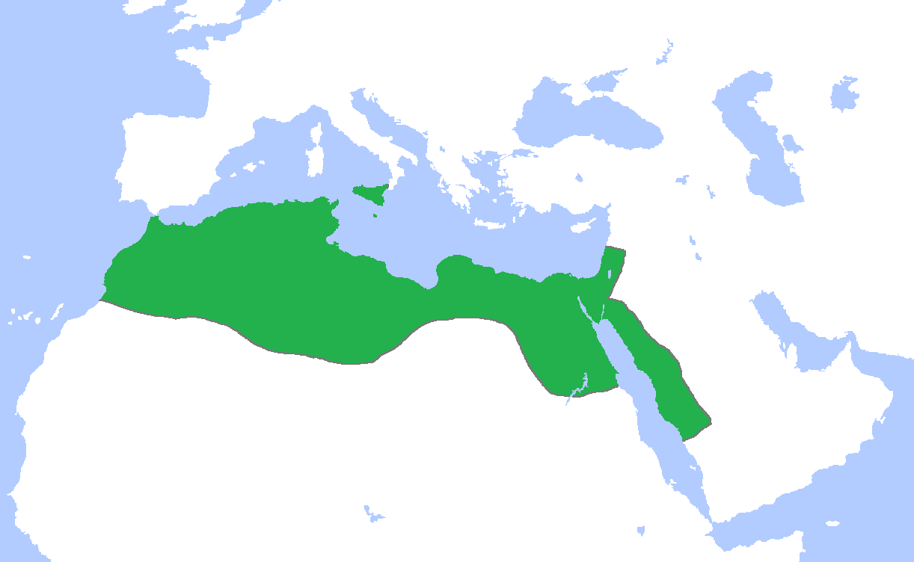
The Fatmid Caliphate (909-1171)
North Africa, Egypt, Western Arabia, and Syria
Formed by decedents of Muhammad’s daughter, Fatima
Still connected to the Abbasid caliphate through religion, language, trade, and the economy

Slide 12
Byzantines, Russians, Turks Interact
Three groups interact in Central Asia.

Slide 13
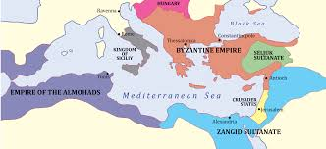
The Byzantine Empire
Justinian
Law Code
Building Constantinople
Hagia Sophia

Slide 14
The First Schism

Slide 15
The Russian Empire
Slavic farmers and traders, later merge with bands of “Rus” (probably Vikings)
Organized into a principality in Kiev
Mongol invasions in the 1200s invaded and ruled all of southern Russia for 200 years (The Golden Horde)
Ivan III gains power, challenges Mongol rule, and establishes the Russian empire (czar)
Czar- Slavic monarchs or supreme rulers, from the Latin Caesar

Slide 16
Turkish Empires in Anatolia
Replace the Abbasids (Muslim) in control of Anatolia
Seljuks- the first group of Turks
Victories in the Crusades
After the Mongol empire around Baghdad crumbled, the Ottoman Turks rose to power in the region

Slide 17
China
Tang Dynasty
Song China
Second larges and longest-enduring empire after the Han
Golden Age- cultural and artistic
Scholar-Officials- expands the civil service exams started by the Hans
Border attacks and internal rebellions led to their demise
Ruled a smaller area than then Tang and Hans but China remained stable, powerful, and prosperous
China becomes the most populous and advanced country in the world
Movable type

Slide 18
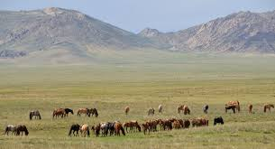
Mongols
Nomads on the Asian Steppes
Pastoralists
Engaged in peaceful trade with settled peoples
Prided themselves on toughness and conducted raids to gain wealth

Slide 19
Genghis Khan
United the Mongol tribes (1200)
Conquers much of Asia
Brilliant organizer, gifted strategist, and used cruelty as a weapon

Slide 20
Khanates After Genghis’ death his sons and grandsons continued conquest. By 1260, divided their empire into four khanates (Regions).

Slide 21
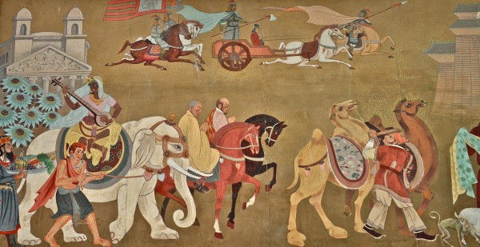
Pax Mongolica
Mongol Peace
Guaranteed safe passage for trade caravans, travelers, and missionaries from one end of the empire to another
Trade becomes more active

Slide 22
Kublai Khan
Grandson of Genghis
Conquers China and founds the Yuan Dynasty
Mongols maintain separate identity from Chinese
Restored the Grand Canal
Foreign trade increased
Marco Polo visits
Dynasty overthrown after Kublai Khan’s death

Slide 23
Early Japan
Not a united country- hundreds of clans controlled their own territories
Religions unite as Shinto- “way of the gods”
Respect for forces of nature and worship of ancestors
Yamato becomes leading clan by 400s
Helped establish the idea of rule by emperor

Slide 24
Japanese Culture
Buddhism- brought by Korean travelers
Mixes with Shintoism
Borrowed culture from China
Adapted to suit their needs and retain traditions

Slide 25
Feudalism
Large landowners set up private armies
Countryside became lawless and dangerous
Farmers and small landowners traded parts of land for protection
Lords gained more power

Slide 26
Samurai
Samurai- “one who serves,” loyal warriors
Bushido- “the way of the warrior,” code of behavior the samurai lived by
Show reckless courage
Reverence for the gods
Fairness
Generosity toward those weaker than himself
Dying an honorable death more important than living a long life

Slide 27
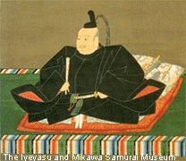
Shogunate
Shogun- military dictator in Japan
Emperor still reigned but the real center of power is the military headquarters
This pattern of government, shoguns ruled through puppet emperors, lasted until 1868

