Slide 1
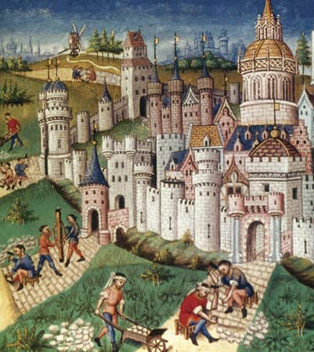
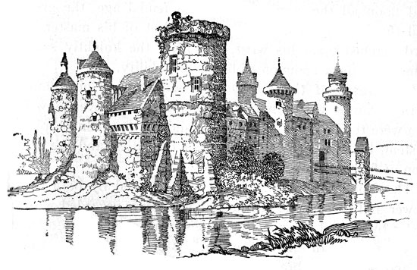
500-1500
The Middle Ages

Slide 2
Constructive Response Question
What combining factors changed Europe from a once flourishing Roman Empire into what we now know as the Middle Ages?

Slide 3
What Will We Learn?
What is the Middle Ages?
What caused the Middle Ages?
Changes that occurred during the Middle Ages

Slide 4
Background
The Middle Ages: What is it?
Time period that existed between the Roman Empire and the Renaissance.
Lasts roughly 1000 years, 500-1500
Other names: The Dark Ages or medieval period.
Often seen as a very bleak and dangerous period

Slide 5
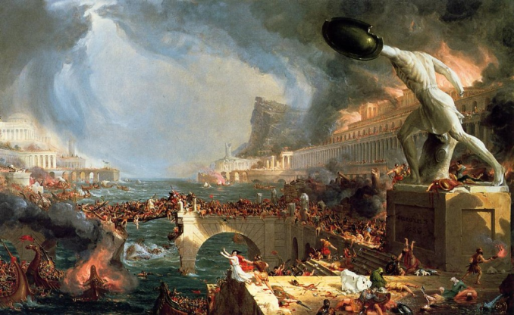
Causes of the Middle Ages
Causes of the Middle Ages
Fall of Rome was caused by invading Germanic tribes

Slide 6
Map Skills
Answer the Geography skillbuilder questions on page 359 about the invasions of Europe
1. What lands did the Vikings raid?
2. Why were the Viking, Magyar, and Muslim invasions so threatening to Europe?

Slide 7
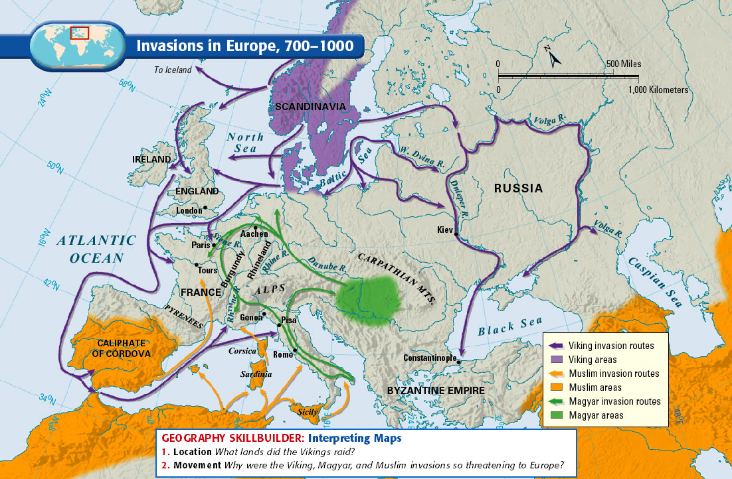
Invasions in Europe

Slide 8
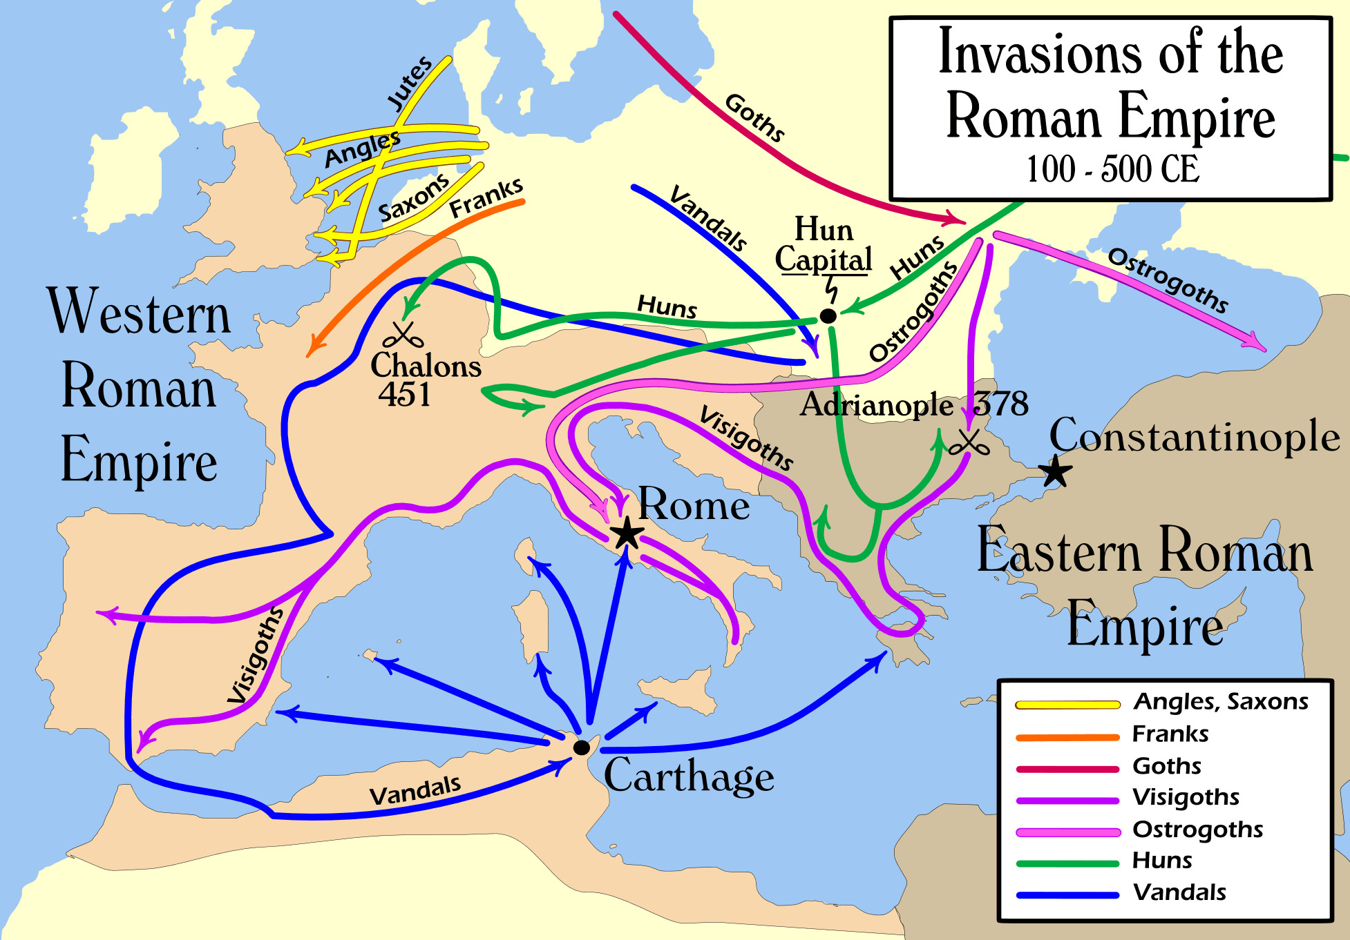
Causes of the Middle Ages
Invasions led to:
Disruption of Trade: Merchant trade collapsed and Europe’s economic centers were destroyed. Money also became scarce.
Downfall of cities: Cities were abandoned as centers of administration.

Slide 9
Causes of the Middle Ages
Europe became rural: Roman cities left without strong leadership
Decline of learning: Germanic invaders could not read or write. Learning became less important as people moved to rural areas.
Loss of a common language: Latin changed as Germanic people mixed with Roman population.
Loss of established government: Germanic tribes did not have written laws nor an orderly government for ruling purposes

Slide 10
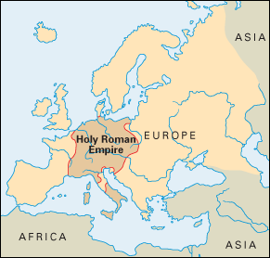
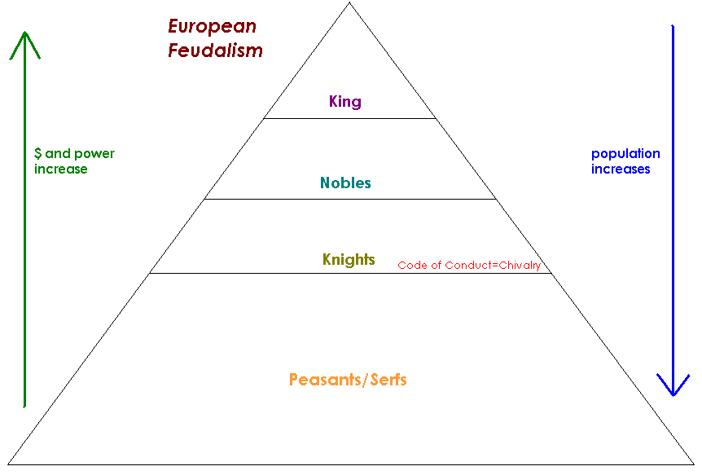
Effects of the Middle Ages
How did the Middle Ages Change Europe (Effects)?
New Germanic Kingdoms emerge (Holy Roman Empire)
Rise of the feudal system in Europe

Slide 11
Draw it out
1.Fill in the European feudal pyramid on your notes using page 361
2. Create drawings of each section of the feudal pyramid that help you remember what each is responsible for. Use class discussion and page 360 (Feudal Pyramid section) to help you.

Slide 12
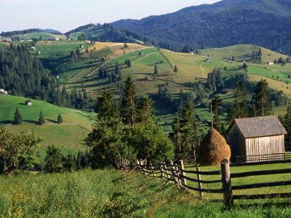
Effects of the Middle Ages
The power of the Christian Church grows rapidly
The power of the pope(s) grows rapidly
Europe became rural
No major emphasis on learning

Slide 13
Effects of the Middle Ages
New languages replaced Latin
Early signs of modern European countries start to appear (England & France)
Rise of Chivalry: a code of behavior for knights in medieval Europe, stressing ideals such as courage, loyalty, and devotion

Slide 14
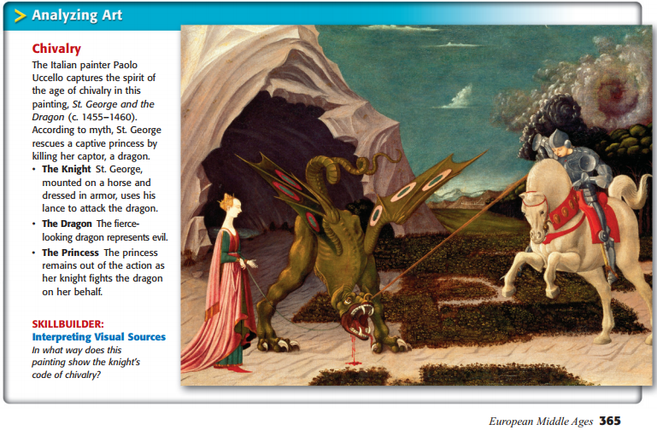
Analyzing Art: Complete the Skillbuilder on pg 365 in your book

Slide 15
Answer the Constructive Response Question in notes
What combining factors changed Europe from a once flourishing Roman Empire into what we now know as the Middle Ages?

Slide 16
Possible Answer for the Constructive Response Question
The factors that contributed to the shift to the Middle Ages were disruption of trade, downfall of cities, Europe became rural, decline of common language, learning and loss of government.
Video: Middle Ages in 3 ½ Minutes
https://www.youtube.com/watch?v=6EAMqKUimr8

